Slide 1
From Zero to DAM!
Eva Radding
Association of Moving Image Archivists
November 8, 2013
Notes:
Intro to Facing History: what we do, since 1970s

Slide 2
Notes:
How we use video
Record of professional development and public events, documentation of classroom use of Facing History
Classroom and on website
Preserve our history and repurpose footage of survivors, scholars, etc.

Slide 3
Notes:
Increasing use of video on website, including creating new content featuring experts and scholars

Slide 4
Opportunity: from print...
Notes:
History of the project
Digitization of video in obsolete formats, videotapes, some in library catalog
Opportunity in large multi-year grant to update content and present in new formats

Slide 5
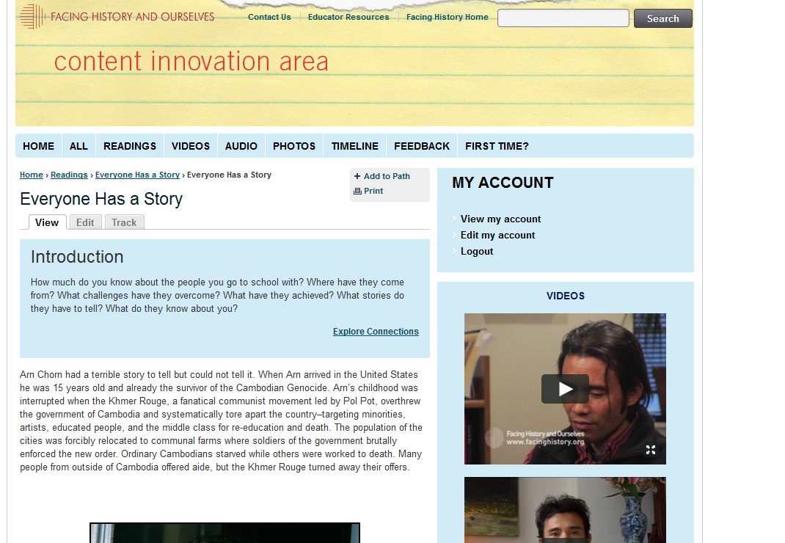
… to multimedia content
Notes:
(example of video content reused for new web content)

Slide 6
DAM Project
Digitization
Conversion of obsolete format and other tape-based video
Digital Asset Management System
Video and image repository for active internal use and archiving
Multimedia project workspace
Publications workspace and repository
Rights management tool
Taxonomy
Consistent organization of content across platforms
Notes:
DAM provides more opportunities than just digitizing videotape
Internal team brought together representatives across organization (video, IT, publications, web team)
Hired AudioVisual Preservation Solutions to bring in expertise and perspective we did not have
Digitization vendor selection and technical support
Discovery, use cases, RFP, vendor demos, selection, ongoing support
Taxonomy

Slide 7
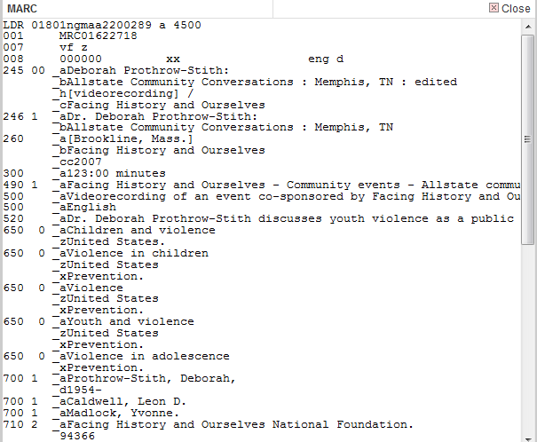
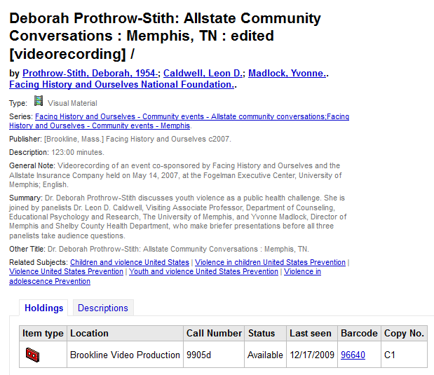
Metadata: from MARC…
Notes:
Where we are now:
2000 videotapes in all formats inventoried, barcoded, digitized, on in-house server and backed up to LTO
Taxonomy in place for DAM and website; all metadata previously in library catalog…

Slide 8
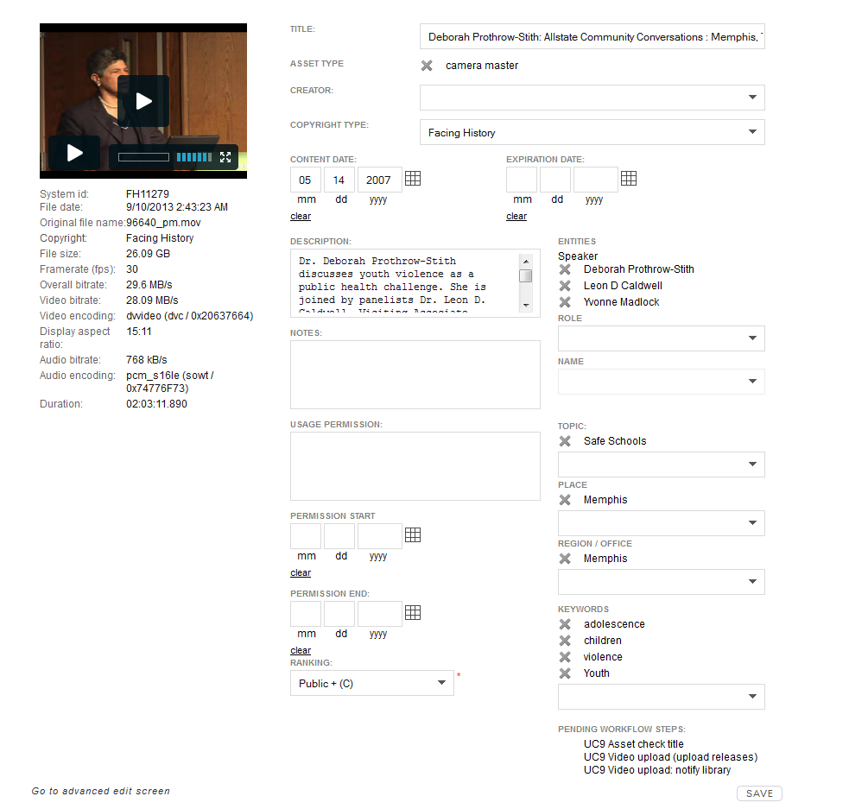
…to Cortex
Notes:
…now mapped to metadata in Cortex
½ our digitized video organized and uploaded
Photos moved from Flickr

Slide 9
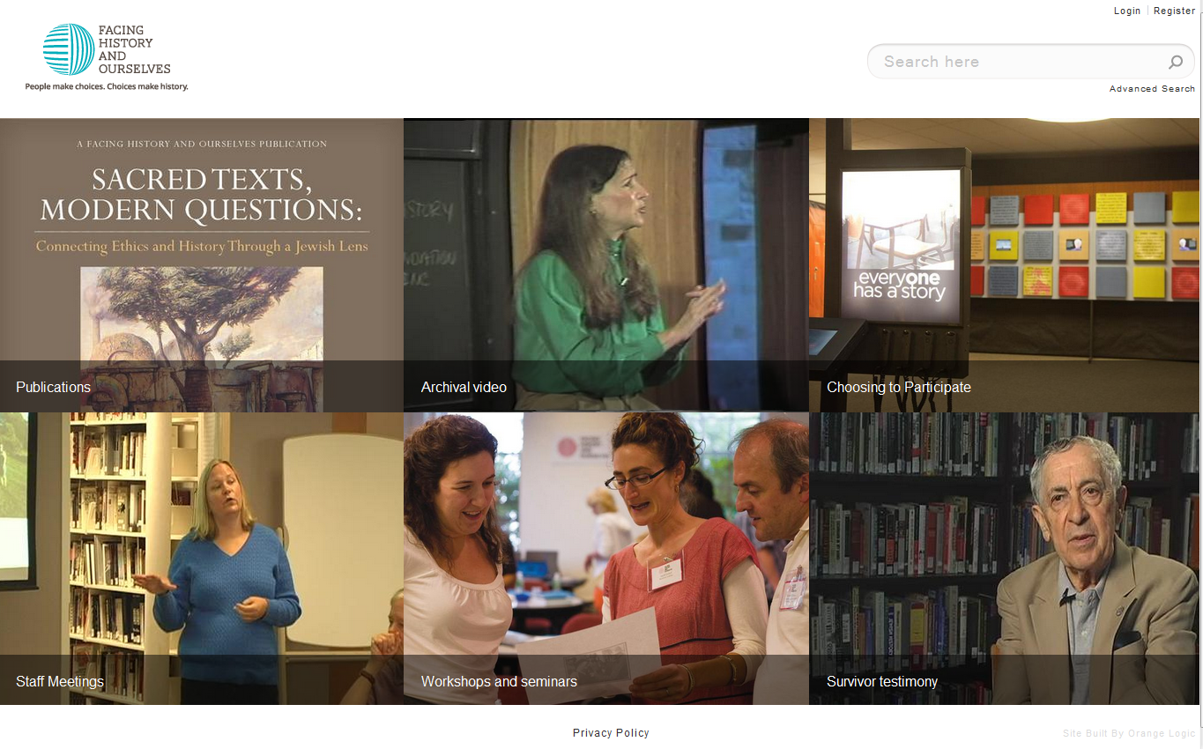
Notes:
2nd prototype, still configuring
Using DAM for video migration project (DAM > Brightcove > Drupal 7 for new website)
Developing new organizational procedures and training plans as capabilities roll out

Slide 10
Lessons learned
Coordinate with organizational priorities
Expect to invest a lot of time
Plan for increased staffing
An existing solution needs customization
Establish priorities
Work with what you have
Cultivate organizational buy-in and communication
Notes:
Coordinate: benefits and drawbacks of being part of a larger project
Time: everything takes longer, so many details (permissions, input and search screens, workflows)
Staffing: Now two full time people
Customization: benefit from other users, contribute new capabilities to the product
Organizational buy-in: keep people interested (naming contest, showing 35-year-old video at 6/13 staff meeting, showing home page, search, and sample use at 9/13 meeting

Slide 11
What’s next?
Attack the backlog
Roll out to entire staff
Configure more use cases
Expand to other materials
Support staff to use the Trove as a vital resource

Slide 12
Eva Radding
eva_radding@facing.org
617-735-1680

