Slide 1

Putting Your Assets on the Map
AMIA Annual Conference, November 2013
Locational Metadata - How to use Geography to Make Assets Discoverable
Colin Mills – Skyworks Ltd.

Slide 2

Why am I Here - 1?
We are not software developers, but
Aerial filming experts with our own archive

Slide 3
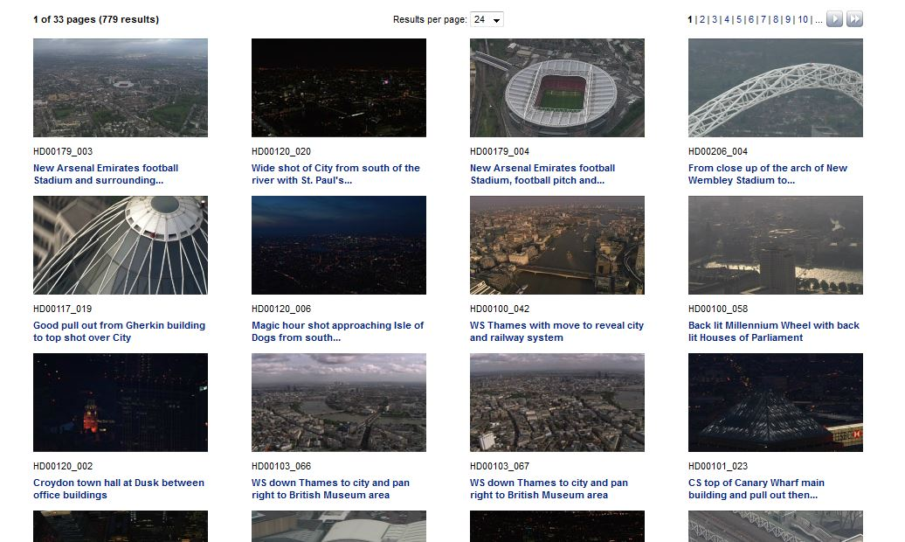
Why am I Here - 2?
... And we thought there must be
A better way to search than this
Notes:
Neither developer nor geolocation expert, but an archive curator
A unique experience of what is possible
A unique non-technical perspective
A practical view on how this technology can help you
All born of a real need
A development journey

Slide 4
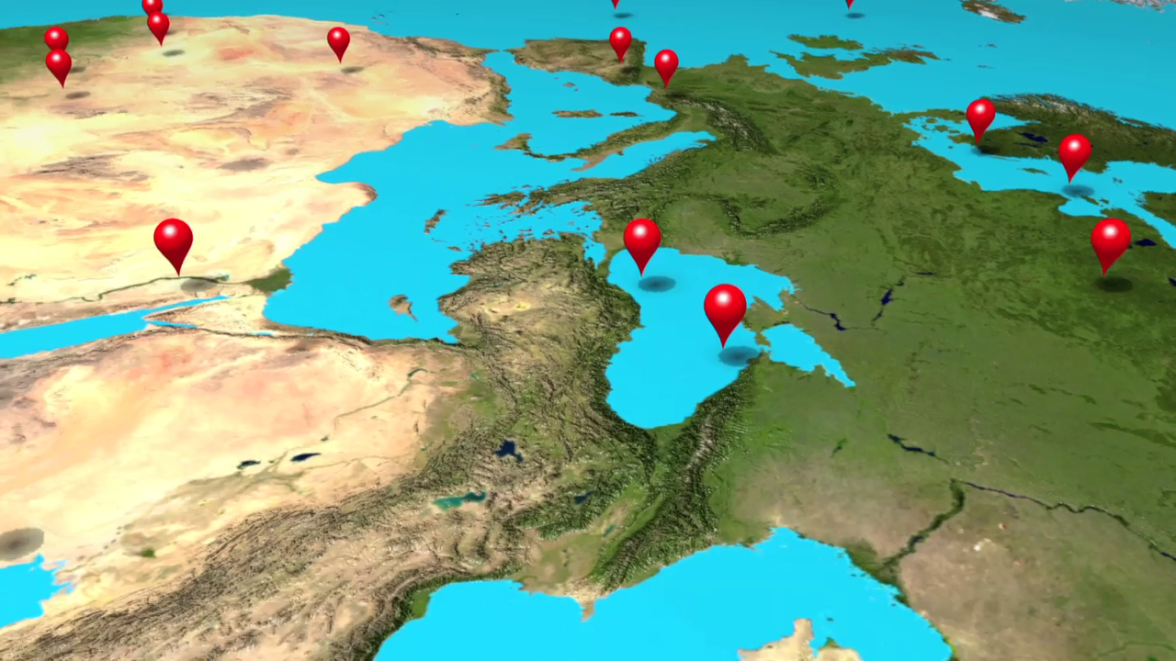
Why am I Here - 3?
Such as seeing results on a map
Notes:
Neither developer nor geolocation expert, but an archive curator
A unique experience of what is possible
A unique non-technical perspective
A practical view on how this technology can help you
All born of a real need
A development journey

Slide 5
Something about Skyworks
So you can see where we are coming from
  World’s largest HD aerial archive
  With a vision to film the world from the air
As a niche archive we need to be discoverable
  120k clips and growing
  Over 1200 hours of HD footage

Slide 6
Relevance Beyond Our Needs
Different types of footage assets
  Long- and short-form, newsreel, and beyond
Different types of metadata
  From basic to sophisticated
In short, anything that is “locationally relevant”

Slide 7
A Vision for Search
Is there too much dependence on text?
How can we make search easier?
The shackle of language
Has search become too smart?

Slide 8
Putting it on the Map
When relevant, as natural as pointing
Language agnostic
A new way to approach searches
A ‘sticky’ way to combine text and visual search
An opportunity for innovation
BUT – an enhancement, not a replacement

Slide 9
The Blueprint
Geocode Metadata
Display on a Map
Administration
Breaking down the process
Notes:
Bite sized pieces
The geocoder
The map
Enhanced metadata

Slide 10
Making it Happen
All is not what it seems...

Slide 11
Why Google doesn’t (always) Work
The first step – surely someone has done this before?
Google, Bing and the usual suspects
  But some conflict with navigation and advertising needs
How intelligence can become stupid
  In second-guessing what you want, these ‘intelligent’ engines can actually get it quite wrong
Notes:
The first step – surely someone has done this before?
Google, Bing and the usual suspects
How intelligence can become stupid
[exmples]

Slide 12
About Geonames
Over 10 million place names
Various languages
‘Features’ index

Slide 13
It’s Tough to Make it Look Easy
Usability was a big issue
  Need to process large quantities of data
  Need to retain an overview AND curate line-by-line
One size does not fit all
    A trained system is necessary to effectively translate your metadata

Slide 14
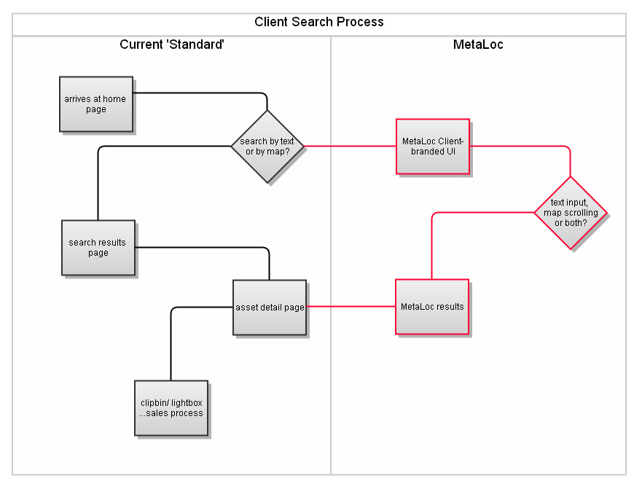
Easy to Implement
It was important to us
that MetaLoc be VERY
easy to integrate with
any site with no need to
change any existing
search systems.

Slide 15
Bringing text back in
But were we throwing the baby out with the bathwater?
  If we can geocode, we can also amplify the metadata
  So combining the best of both worlds
Which would give text search a new role

Slide 16
MetaLoc in Action
Demonstration
The next slide shows a user screen shot, showing how Wikipedia data is scraped for info text – this is also used to augment the keywords, making the asset more easily discoverable. Note that the map is deliberately simplified – this can be changed to be any level of colour or detail required.
The slide after is from the admin interface and shows the detail pane, with the search sequence used for that particular asset.

Slide 17
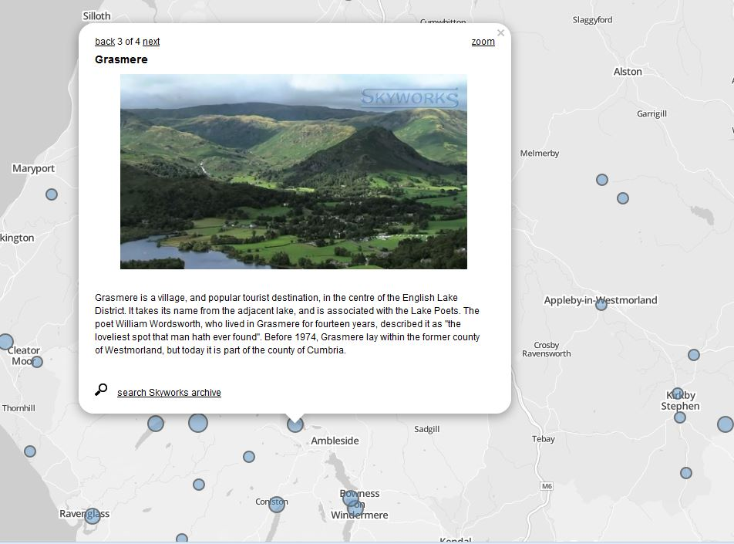

Slide 18
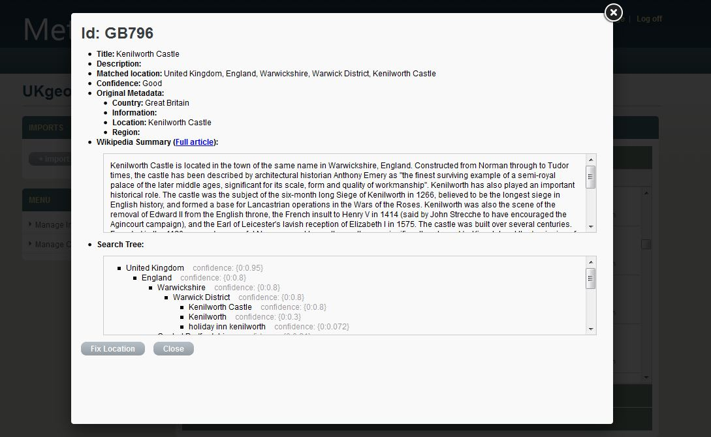

Slide 19
The Commercial Break
If you are interested in testing MetaLoc, we are interested in setting up a test for you. What we need is:
  Around 3000 records
  Metadata in our format (contact us for specification)
Then,
  We give you a test website to try for a few weeks
  www.metaloc.com (use the contact box)

Slide 20
Thank You!

