Slide 1
Permanent Digital Data Storage: The Nature of Bits
Barry M. Lunt, PhD; Professor, Information Technology
Matthew R. Linford, PhD; Professor, Chemistry
Robert Davis, PhD; Professor, Physics

Slide 2
Presentation Outline
Introduction
What’s ideal, why it matters
State of today’s storage
The nature of data failures
A different paradigm
Today’s storage options
Format obsolescence
Conclusion

Slide 3
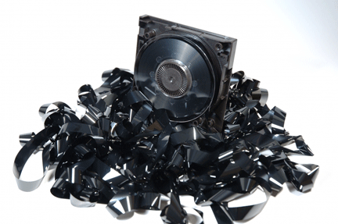
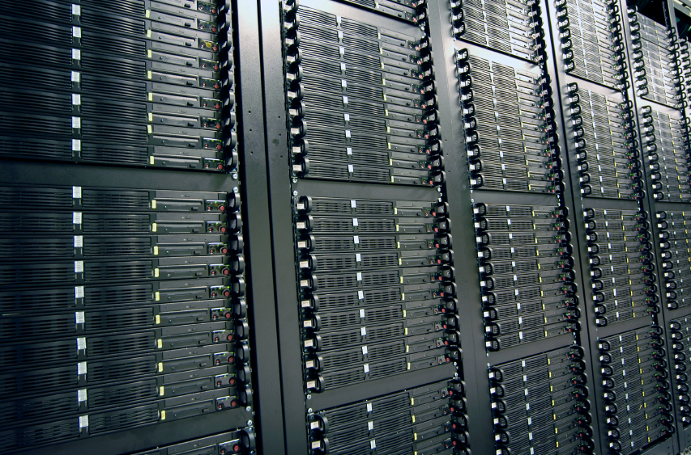
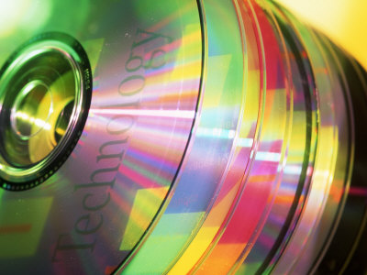
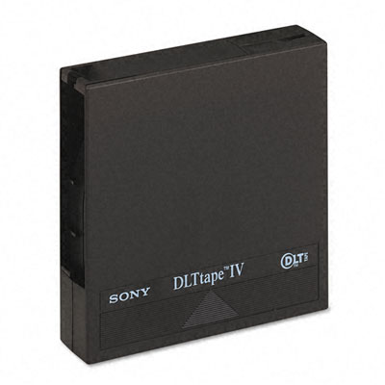
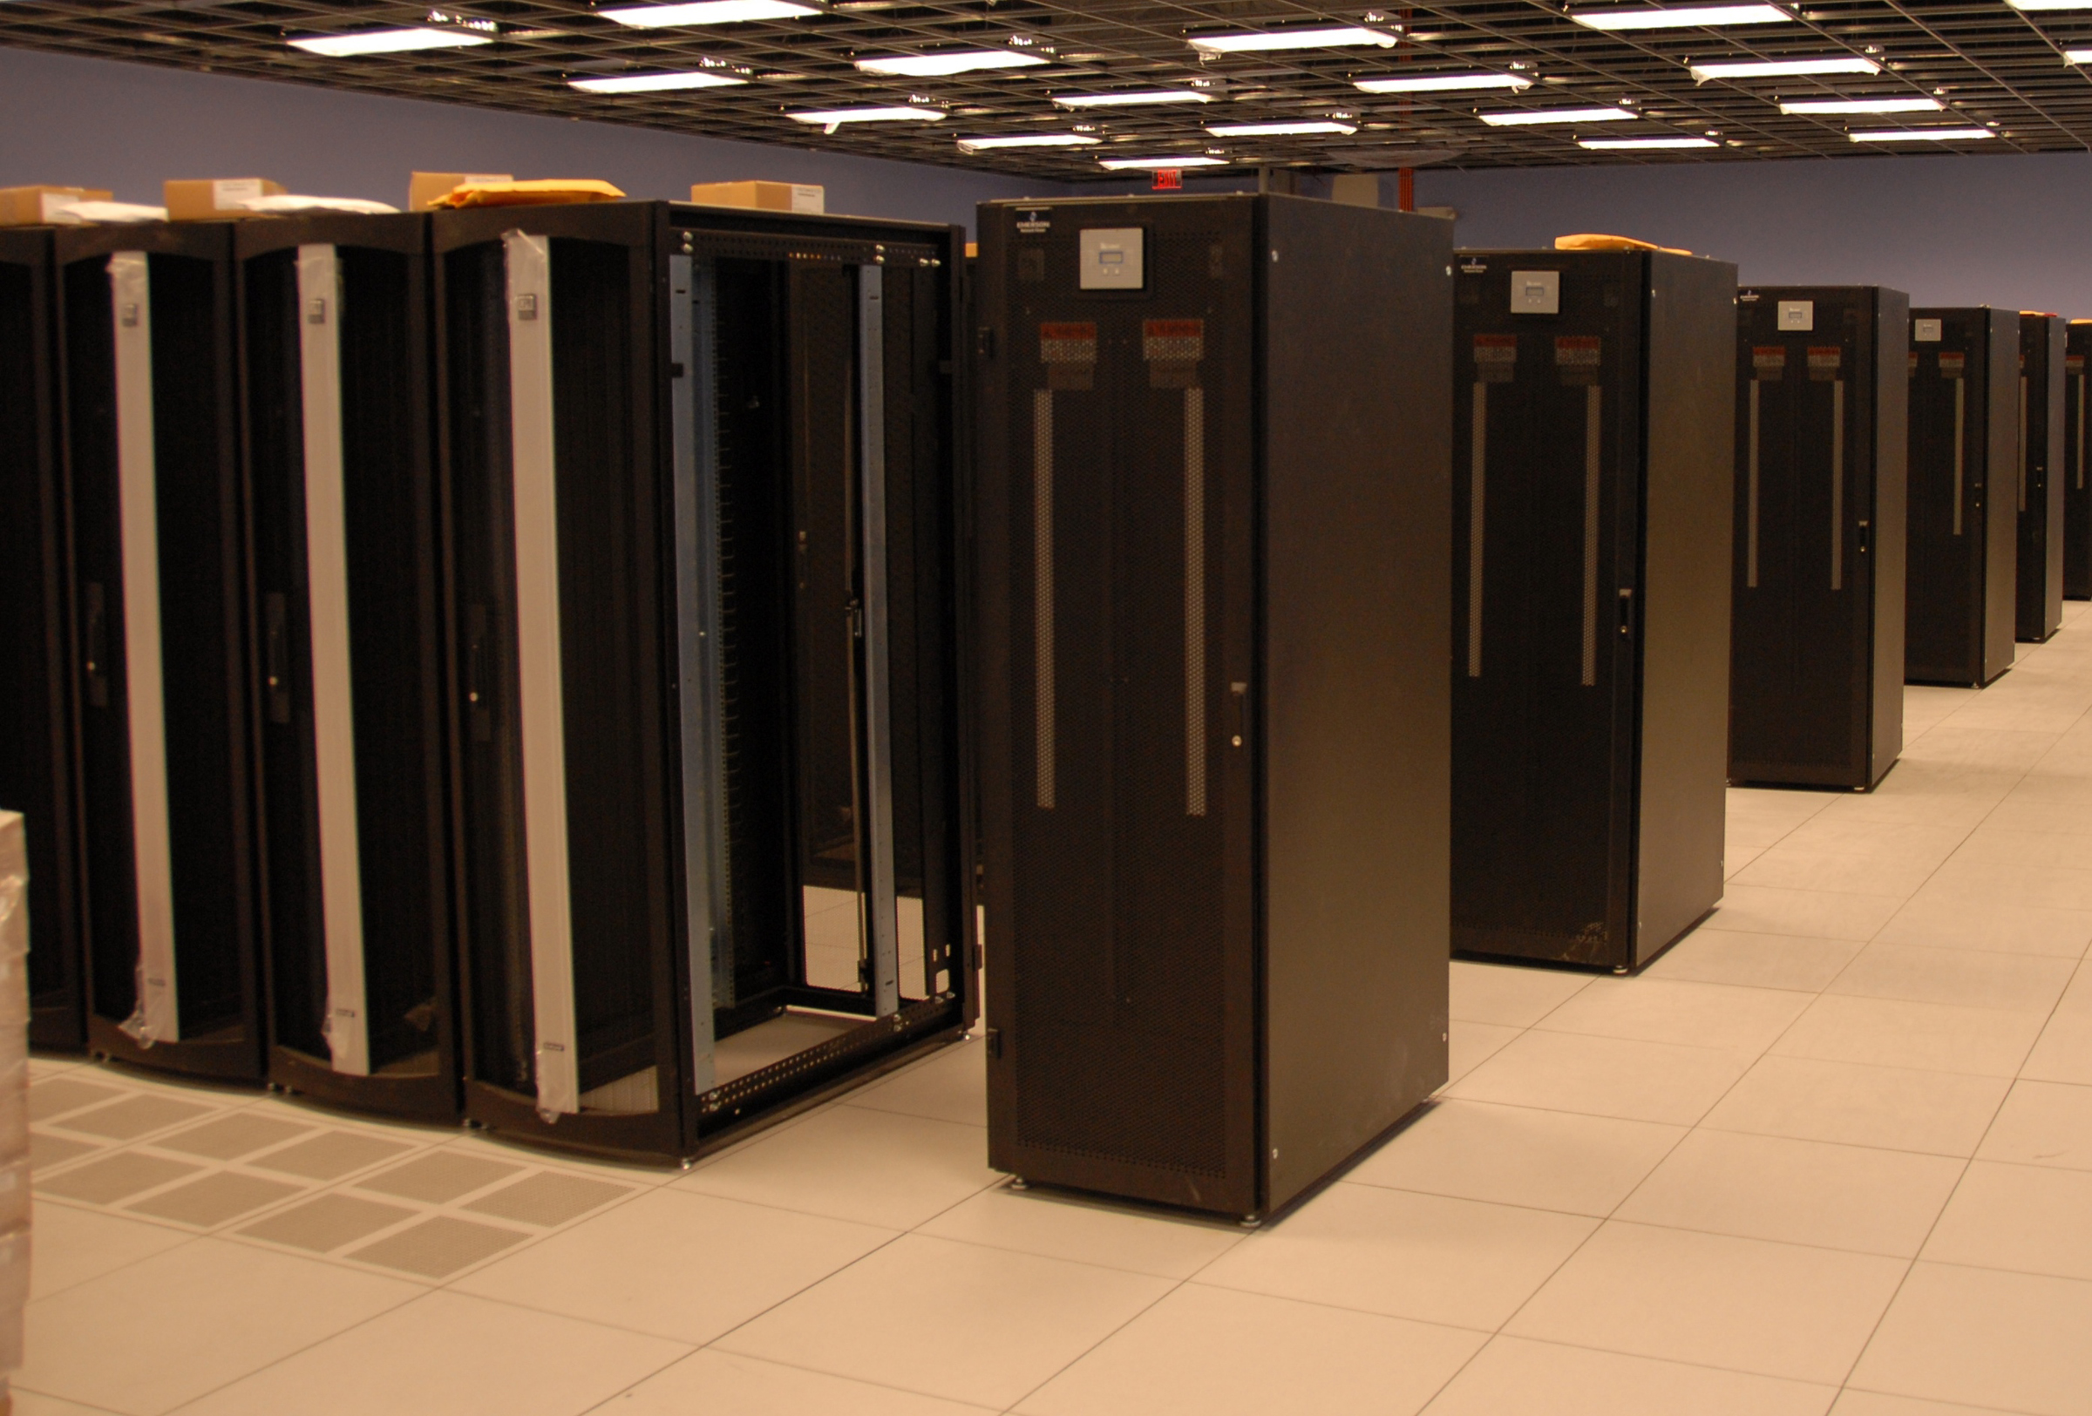
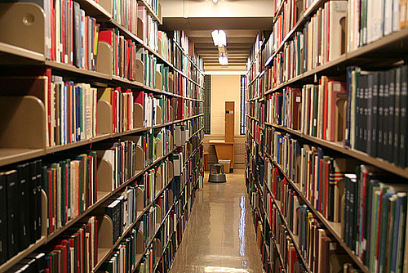
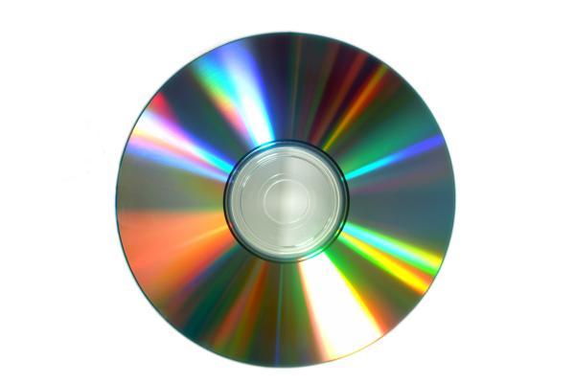
Archiving:
1. No Active Maintenance
Notes:
What do we mean by true archival media? 5 things: no active maintenance; no special storage conditions; last ≥100 years; no power required; easily transported. Just like paper!

