Slide 1
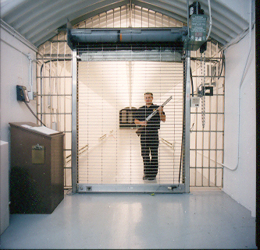
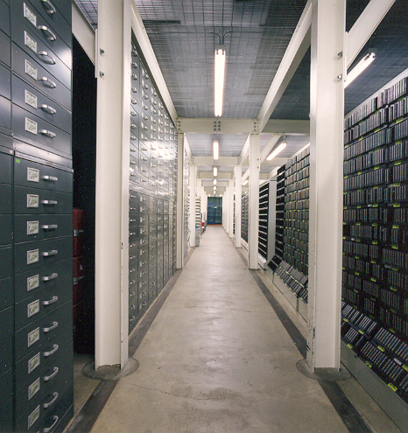
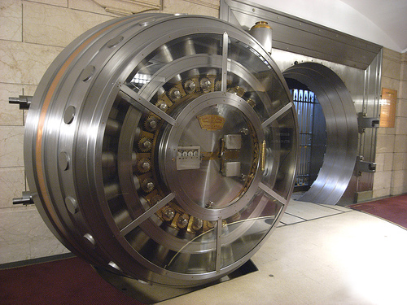
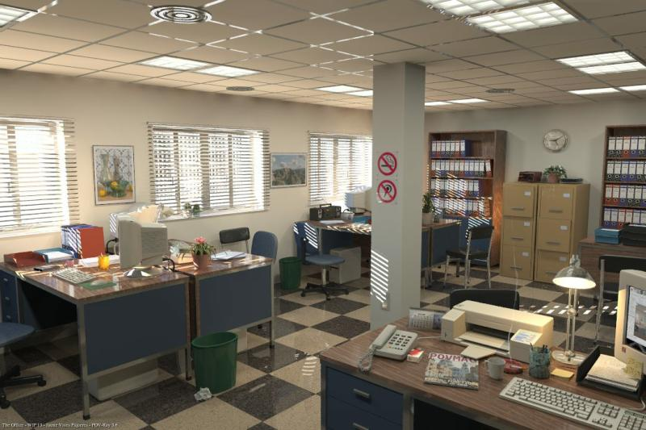
Archiving:
2. No Special Storage
Conditions

Slide 2
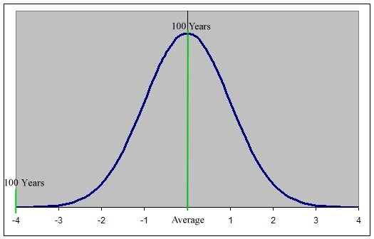
Archiving:
3. Last ≥100 Years

Slide 3
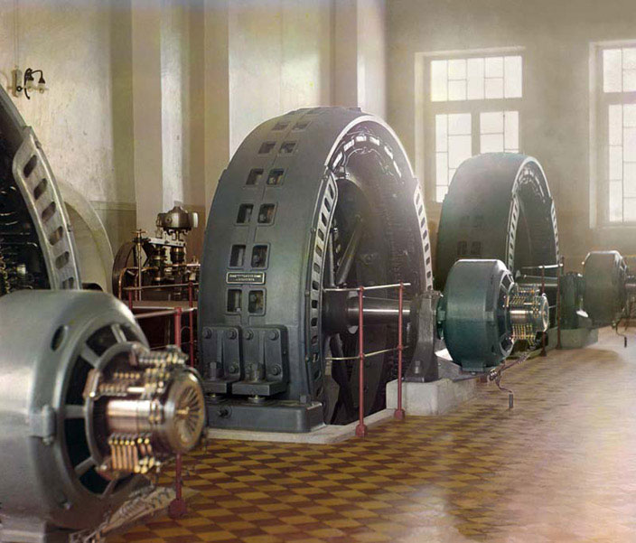
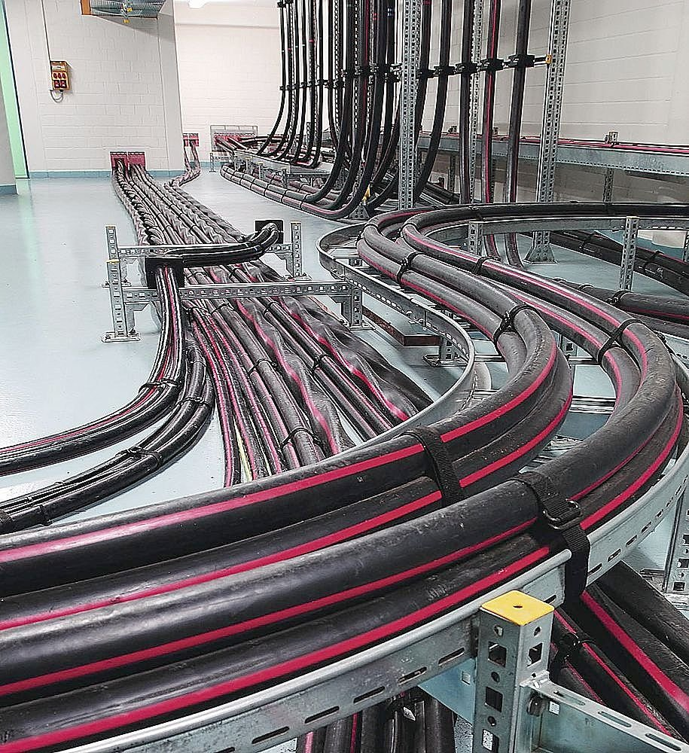
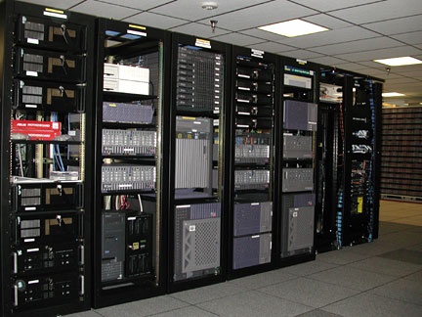
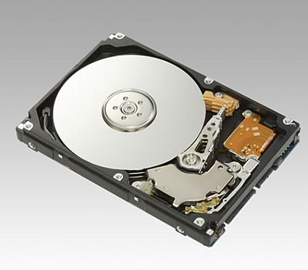
Archiving:
4. No Power Required
(to preserve it)

Slide 4
Archiving:
5. Easily Transported

Slide 5
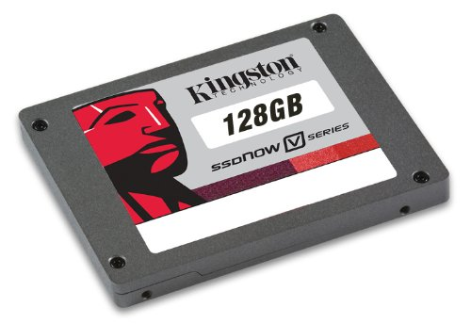
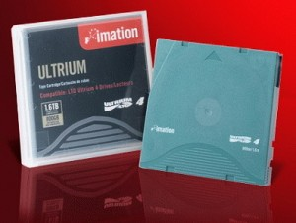
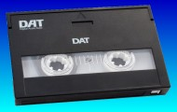
Today’s Technology Options:
Magnetic Tape
Flash
Optical Discs
Hard-Disk Drives

Slide 6
State of (Digital) Storage Permanence
Magnetic core (early days): permanent (>200 years)
SRAM, DRAM: milliseconds
HDDs: 3-7 years
Magnetic tape: 20-30 years (advertised); 5-7 years in practice
Flash memory (Solid-State Drives): 8-10 years
Optical discs: Recordables ≈ 20 years (advertised); 3-5 years in practice
Archival recordable optical discs (except for M-Disc): 100 years advertised; 5-10 years in practice
“Optical Disc Life Expectancy: A Field Report (ISOM/ODS 2011, Lihue, Kauai, Hawaii)
M-Disc: DVD >1000 years; BD >300 years

Slide 7
“Optical Disc Life Expectancy: A Field Report (ISOM/ODS 2011, Lihue, Kauai, Hawaii)
Barry M. Lunt, Matthew R. Linford, Douglas Hansen
Holdings of two libraries – noncirculating discs
Library 1: 8,500 DVDs, 8 brands, standard & archival
Library 2: 18,000 CDs, all archival
Findings:
≈2% loss/year (permanent data loss)
Significant increase in BLER and PIESum8 in all discs (some far beyond spec)

