Slide 1
Does It Really Need to Be This Way?
What is digital data?
  Some kind of physical property
  Two stable states, preferably high contrast
  Can be permanent
    RLG DigiNews, Aug 15, 2005, Vol 9, #4
    Vivek Navale, NARA, “Predicting the Life Expectancy of Modern Tape & Optical Media”
    “[Research] predicts a mean life time of 1592 years for CD-ROMs stored under these conditions.”

Slide 2
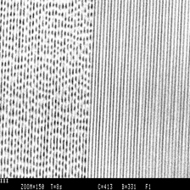
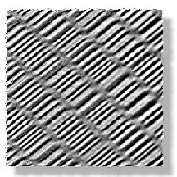
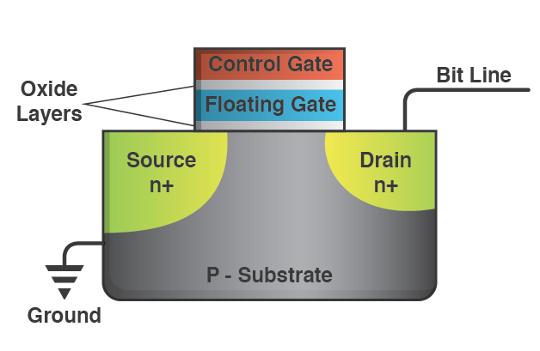
What Really Is Digital Data?
Some kind of physical property
  Two stable states
  Can be read optically or electronically or magnetically
  Recordable Optical Discs Magnetic (HDDs, Tape)
  Flash/Solid-State

Slide 3
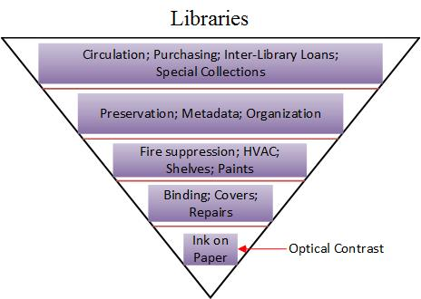
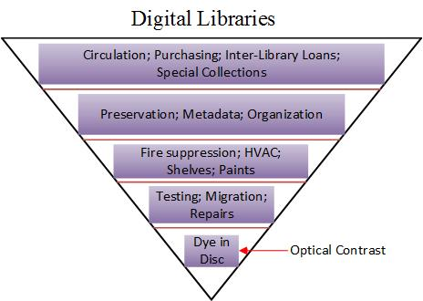
What Is the Place of Digital Data in Archiving?
Persistence of marks is the sine qua non of data archiving.

Slide 4
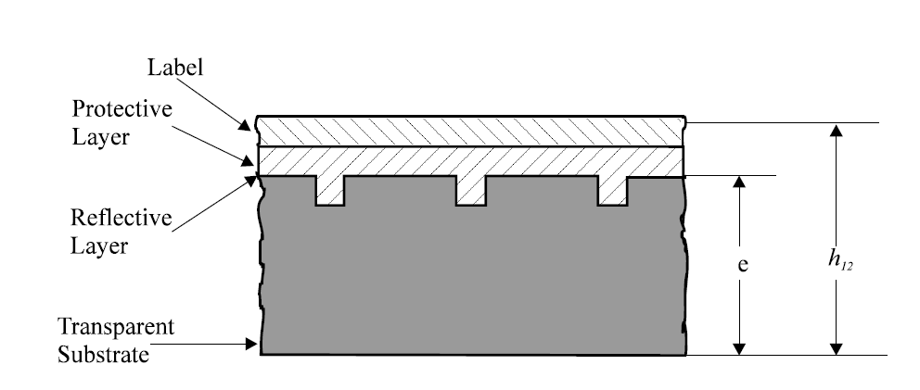
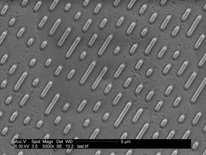
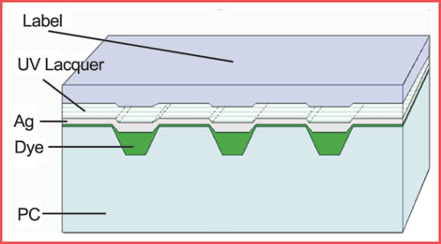
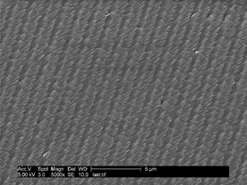
Optical Discs
CD-ROMs:
CD-Rs:

Slide 5
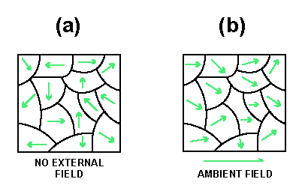
Why Is Digital Data Ephemeral?
It’s always been that way
  Except for magnetic core
  Magnetic tape
    Stores data as magnetic domains in a magnetic material
    SNR degradation proportional to temperature
    Also suffers from delamination

Slide 6
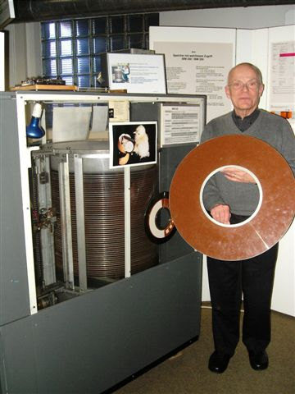
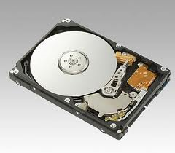
Hard-Disc Drives
The primary data storage technology in the world
Tens of millions of units sold every year
Basic technology unchanged for >50 years
Catastrophic + slow failure mechanisms

Slide 7

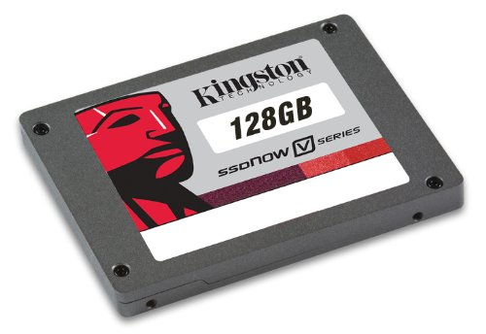
Flash (Solid-State Memory)
Two main options:
  Flash drive (aka memory stick, jump drive, USB drive, etc.)
  SSD (solid-state drive)
    Just a lot of Flash memory, made to look like a HDD to your computer

Slide 8
Flash (Solid-State Memory), cont’d
Basic technology extant since 1970s (EEPROM)
Stores data as a charge on a floating gate

Slide 9
1350 Years? How Do You Know?
Accelerated aging
  Used in paint industry, then automotive, etc.
  Find out what causes degradation, then accelerate it
  Arrhenius, Eyring equations – extremely effective
Digital errors: health monitor of digital data
  Readily readable
  Easy to analyze
  Directly correlates with (and is caused by) degradation
Degradation can be mechanical, chemical, magnetic, or material
Notes:
Paint: temperature, humidity; automotive: wear; ICs: temperature, humidity, voltage

Slide 10
What Is Permanent?
For Paper: “Permanence: The ability of paper to last at least several hundred years without significant deterioration under normal use and storage conditions in libraries and archives.” (ANSI/NISO Z39.48-1992 (R1997), “Permanence of Paper for Publications and Documents in Libraries and Archives”)
A recent proposal for digital data: Permanence: The ability of a digital data storage medium to last at least two hundred years without significant deterioration under normal use and storage conditions in libraries and archives. This means there is a 99.99% confidence of complete data recovery using the intended read mechanism or hardware.

Slide 11
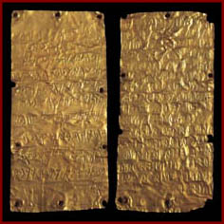
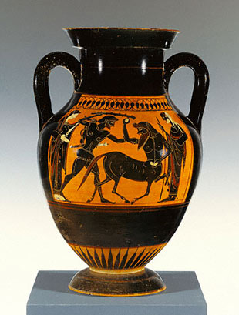
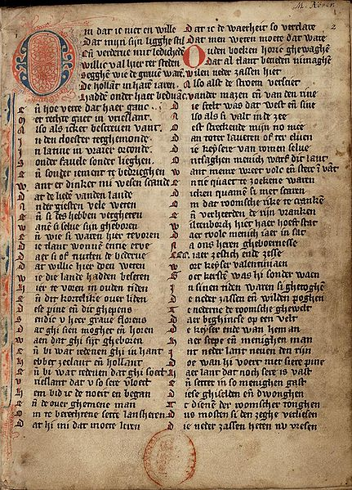
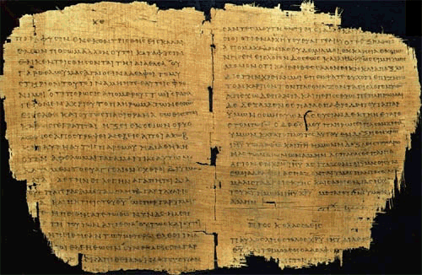
Does It Really Need to Be This Way?
NO!
A Materials Perspective
  Some materials last a VERY long time
    Gold ≈500 BCE
    Pottery ≈500 BCE
    Ink on parchment
    ≈1400 CE
    Ink on paper
≈250 CE

Slide 12
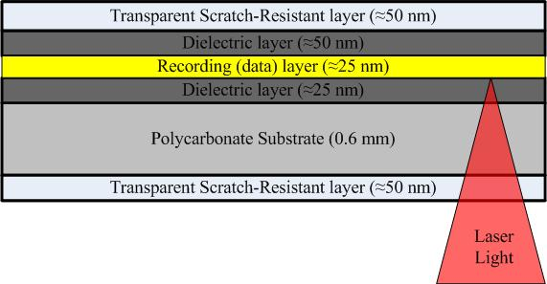
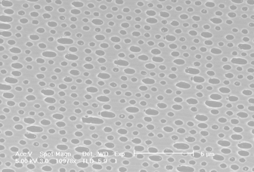
M-Disc Approach
Stable materials on stable substrate
Permanently altered by recording process
Without hardcoat: LE ≈ 1000 years
With hardcoat: LE >> 1000 years

Slide 13
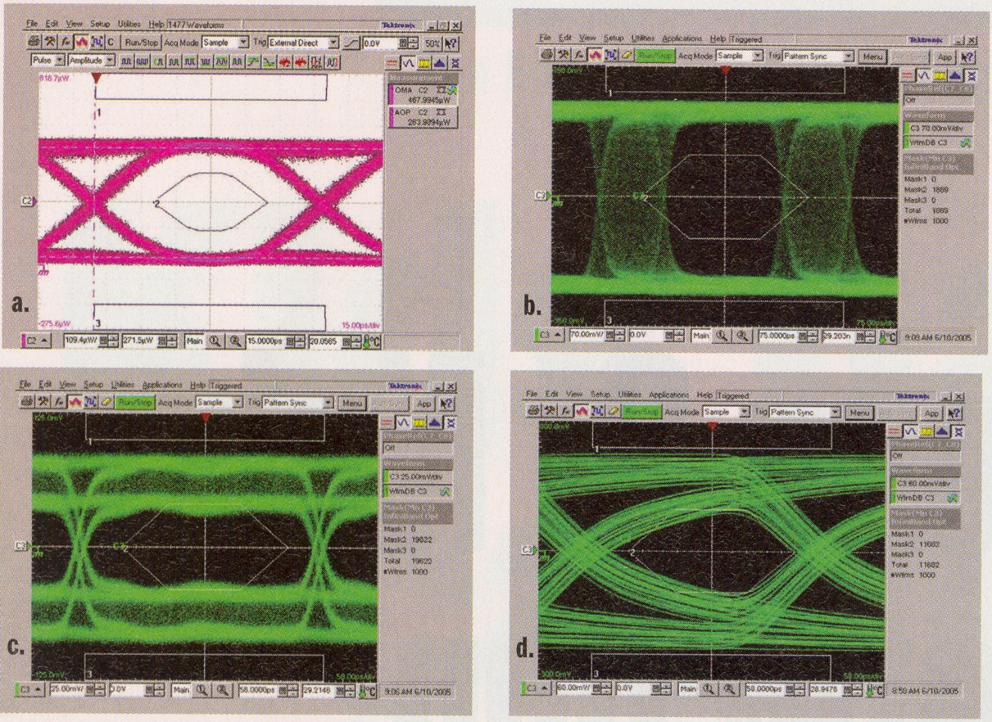
What Is a Digital Error?
All forms of digital data are converted to these signals when the data is read back.

Slide 14
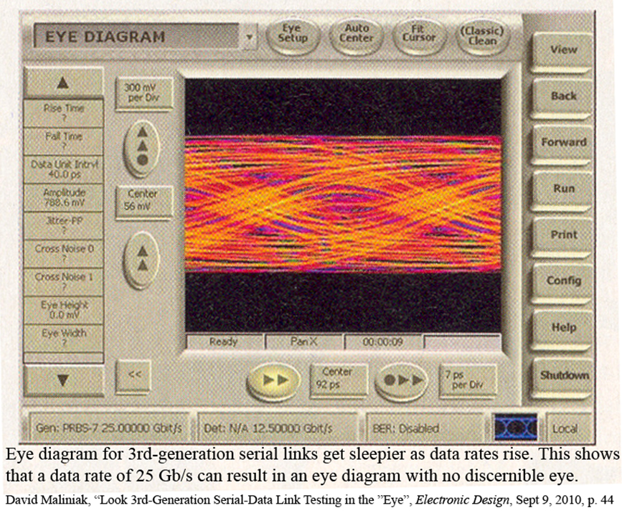
What Is a Digital Error?

Slide 15
How Frequent Are Digital Errors?
}
Optical Discs:
1/200 (2E-2)
Magnetic Tape:
1/10,000 (1E-4)
Hard-Disk Drives:
1/2,000 (2E-3)
Flash Drives
1/1,000,000 (1E-6)
REALLY?
But with ECC:
1E-20

Slide 16
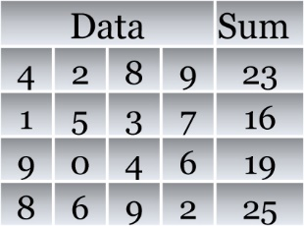
How Do We Deal with That?
Redundant data (Error-Correction Coding)
Data |  |  |  | Sum
4 | 2 | 8 | 9 | 23
1 | 3 | 3 | 7 | 16
9 | 0 | 4 | 6 | 19
8 | 6 | 9 | 2 | 25

Slide 17
How Do We Deal with That?
Redundant data (Error-Correction Coding)
Data |  |  |  |  |  |  |  | Parity
1 | 0 | 1 | 1 | 0 | 1 | 1 | 0 | 1
0 | 0 | 1 | 0 | 1 | 1 | 0 | 0 | 1
1 | 1 | 1 | 0 | 0 | 1 | 1 | 1 | 0
0 | 0 | 1 | 0 | 0 | 0 | 1 | 0 | 0
1 | 1 | 0 | 1 | 1 | 1 | 1 | 0 | 0
0 | 0 | 0 | 1 | 0 | 0 | 1 | 0 | 0
1 | 1 | 1 | 1 | 0 | 1 | 1 | 1 | 1
1 | 0 | 0 | 1 | 0 | 1 | 1 | 0 | 0
1 | 1 | 1 | 1 | 0 | 1 | 1 | 0 | 0/1
Data |  |  |  |  |  |  |  | Parity
1 | 0 | 1 | 1 | 0 | 1 | 1 | 0 | 1
1 | 0 | 1 | 0 | 1 | 1 | 0 | 0 | 0
1 | 1 | 1 | 0 | 0 | 1 | 1 | 1 | 0
0 | 0 | 1 | 0 | 0 | 0 | 1 | 0 | 0
1 | 1 | 0 | 1 | 0 | 1 | 1 | 0 | 1
0 | 0 | 0 | 1 | 0 | 0 | 1 | 0 | 0
1 | 1 | 1 | 1 | 0 | 1 | 1 | 1 | 1
1 | 0 | 0 | 1 | 0 | 1 | 1 | 0 | 0
0 | 1 | 1 | 1 | 1 | 1 | 1 | 0 | 0/1

Slide 18
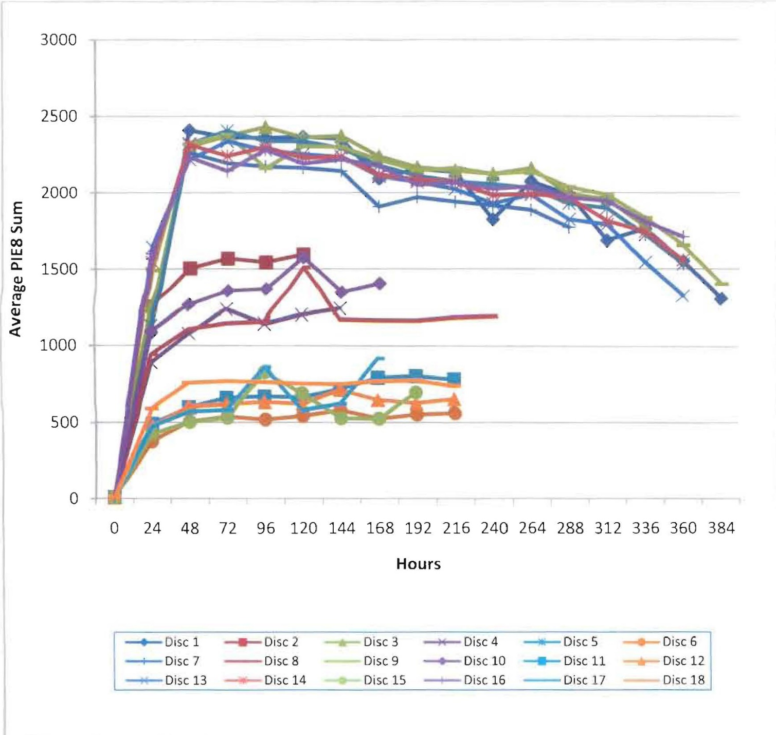
Data Health: Digital Errors

Slide 19
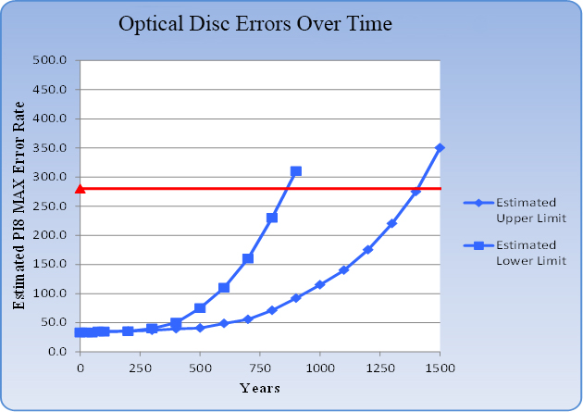
Evidence from Our Research

Slide 20
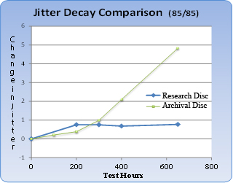
Evidence from Our Research:
Jitter

Slide 21
Status of Archival Options
Now a new standard (DVD-M)
Optical disc library systems now available
  HLDS: 800 discs, single 8-U = 160 TB; x10 = 1.60 PB/rack
  Sony: 10-disc cartridges, 30 slots, 1.5 TB/cartridge = 45 TB
  HIT (DiscArchival.com): 30 TB nearline (Tier 3)

Slide 22
Storage Tiers
Frequently accessed, always available (HDDs); access time ≈ 10 ms
Less frequently accessed, but must be online (HDDs or tape); access time ≈1 sec
Event-driven, rarely-used data (ODs or tape); access time ≈30 sec
Dark storage, truly archival, store and forget; access time ≈1 day

Slide 23
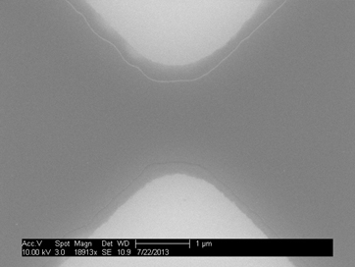
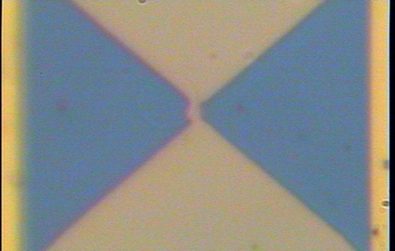
Research: Permanent Solid-State Storage
PROM, but with
no reliability problems
Potential density of flash

Slide 24
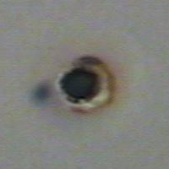
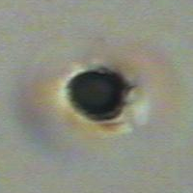
Research: Permanent Optical Tape Storage
Tape, but with no reliability problems
  Will not delaminate
  As permanent as M-Disc
Potential capacity of LTO tape
Actual marks, seen with optical microscope
Simulation of writing to optical tape. Note that most heat is confined to upper 1µm of tape, and high heat to only the recording layer.

Slide 25
What About Format Obsolescence?
Always an issue
Historical lessons
  Linear A (Minoan, isle of Crete)
  Latin
Persistence of marks is the sine qua non
We deciphered hieroglyphs only because:
  So many persisted
  The Rosetta Stone was not blank

Slide 26
Conclusion
Permanence is very difficult to achieve, but can be done.
We should start to care about this – there are now increasing options.
More research is in progress.

Slide 27
Questions/Comments/Thoughts?

