Slide 1
Competency-Based Frameworks for Moving Image Archiving Education
Karen F. Gracy
School of Library and Information Science
Kent State University

Slide 2
AV Archiving Education Today
Graduate degree and graduate certificate programs:
3 in US: UCLA, NYU, GEH/U. of Rochester (U.S.)
1 in Canada: Ryerson
4 in Europe: University of Amsterdam (Netherlands), University of Lausanne (Switzerland), Stuttgart State Academy (Germany), FAMU (Prague, Czech Republic)
1 in Asia: Tainan National University (Taiwan)
1 in Australia: Charles Sturt University
Notes:
US: UCLA, NYU, GEH/U of Rochester, ??
Canada: Ryerson U.
UK:
Europe: Amsterdam, ???
Australia: ???

Slide 3
AV Archiving Today (cont.)
Numerous LIS/I-School/Archives programs with relevant coursework (guesstimate: approx. 20-30% of schools offer courses relevant to AV archiving)
UCLA program transitioning from separate MIAS degree to specialization within MLIS program.
Numerous short courses and workshops offered via AMIA, FIAF, other archival associations, regional preservation networks, and other continuing education providers.

Slide 4
Challenges for AV Archiving PROFESSIONALIZATION, AND Education Development and Evaluation
No graduate level degree or certificate program in audio archiving;
… although covered to some extent in some of the graduate archives courses and moving image archiving/preservation programs, and CE offerings.
No clear path for established archival professionals to ramp up in the AV area if their previous education was not sufficient.
No attempts to distinguish between entry-level, mid-career, and late-career expectations for field-specific knowledge and competencies.
No certifying body for audiovisual archiving programs or practitioners;
Several abortive efforts aimed at establishing a system for accreditation or certification for moving image archivists in the last 15 years (never progressing beyond conversations at AMIA meetings).
No commonly agreed-upon guidelines or competency framework for developing curriculum in this area, at either graduate level or for professional development

Slide 5
Why Now?
Previous conversations about developing guidelines for AV Archiving in the 2000’s were premature.
Most established programs were too new at the time.
Programs needed to go through 2-3 cycles of curriculum development and revision in order to be prepared to talk about field-wide curriculum guidelines.
The digital transition …
Has heavily impacted the nature of audiovisual archiving work, which means that core knowledge/competencies have changed dramatically in a short period of time.
Educators are now ready to take the lead.
There is now more acceptance of formal educational preparation for AV archivists, rather than the apprenticeship model of education previously dominant in this field.
The shift of responsibility for leading development of guidelines must shift to educators, rather than being led by practitioners, although educators continue to need significant input from practitioners about expectations for skills of AV professionals.

Slide 6
Considering A New Model for Educating AV Archivists
The Competency-Based Approach

Slide 7
Competencies—What Are They?
A competency is …
“ … the capability to apply or use a set of related knowledge, skills, and abilities required to successfully perform ‘critical work functions’ or tasks in a defined work setting.”—University of Texas, School of Public Health

Slide 8
Types of Competencies
From human resources definitions:
Professional/Organizational—generic/core competencies required of all professionals in a field (can be behavioral, “soft” skills or core subject knowledge).
Functional—standards of performance needed by an individual working in a specific role or function (could be technical expertise and/or specialized knowledge).
Job—specific behaviors, skills, knowledge sets required for exceptional performance in a specific job.
Leadership—factors that lead to success in managerial, executive, and administrative positions.
In an educational setting, we tend to be more focused on the first two types (as they often relate more to student cognitive development), but …
We should also provide some opportunities to develop competencies in the 3rd and 4th categories via activities that occur outside the classroom (internships/practica, social activities, problem-solving activities)

Slide 9
Three Primary Domains of Learning
To design competencies for a program or field, one should ideally consider the three primary learning domains:
Cognitive Domain
Psychomotor Domain
Affective Domain

Slide 10
Cognitive Domain
Reflects Bloom’s Taxonomy (1956) of learning
Knowledge, Comprehension, Application, Analysis, Synthesis, and Evaluation.
Often the primary focus of tertiary education
Helps students acquire knowledge of a particular discipline or field (the theoretical constructs and their historical contexts)

Slide 11
Psychomotor Domain
Involves skills requiring physical movement, coordination, and/or use of the senses such as sight, hearing, smell, touch, etc.
Levels of learning include imitation, manipulation, precision, articulation, and naturalization.
While often underplayed in graduate education (assumption is often that students will gain many of these necessary skills in their first professional job) …
In the AV archiving field it is essential that students make initial steps toward mastery of these skills to be successful in obtaining their first professional position.

Slide 12
Affective Domain
Includes those “soft skills” that we are interested in cultivating (communication, project and task management, teamwork, etc.).
Levels of learning include receiving, responding, valuing, organizing, and characterizing.
The classroom should not be the only place where this learning occurs (other settings can include internships, conferences, social gatherings, etc.).

Slide 13
What’s the Difference Between a Competency and a Learning Objective?
“Competencies define the applied skills and knowledge that enable people to successfully perform their work while learning objectives are specific to a course of instruction.”
“Competencies are relevant to an individual’s job responsibilities, roles, and capabilities. They are a way to verify that a learner has in fact learned what was intended in the learning objectives.”
“Learning objectives describe what the learner should be able to achieve at the end of a learning period. Learning objectives should be specific, measurable statements and written in behavioral terms.“
“In short, objectives say what we want the learners to know and competencies say how we can be certain they know it.“

Slide 14
What Are “Core Competencies”?
Core competencies are those skills and knowledge that are valued across an academic program area or profession.
They are used to align particular learning outcomes for courses to a larger set of expectations for the program or to educational guidelines developed for a field or profession.
Examples:
ALA’s Core Competences of Librarianship, http://www.ala.org/educationcareers/sites/ala.org.educationcareers/files/content/careers/corecomp/corecompetences/finalcorecompstat09.pdf
Core competencies are best identified through a systematic process of building a larger framework of competencies for an area or profession.

Slide 15
Competency Framework development
Why do we need to do it?

Slide 16
What’s the Purpose of Competency Development?
It helps us focus on what students can *do* upon completion of a learning module, course, or program, not just on what they know.
It provides concrete evidence that they can:
Apply what they know in a variety of settings;
Be able to analyze and evaluate new problems and situations;
Create solutions that may integrate new tools and systems to improve the final outcome.

Slide 17
Competencies as Confidence-Builders
If written correctly, competencies should translate into student confidence in applying knowledge to new situations and new problems (not just knowing particular tools, processes, and work environments).
A competency-based approach can be particularly successful in online or blended learning environments.
Can help build employer confidence in graduates of online programs, where many in the profession are still wary.

Slide 18
What is a Competency Framework?
In HR parlance, a “competency framework” is a structure that sets out and defines each individual competency (such as problem-solving or people management) required by individuals working in an organization.
In educational settings, we can interpret competency framework as a structure that can guide curriculum development and implementation for academic programs.
While an individual program can establish its own competency framework, there is also value in building one that the field or profession endorses (often through a professional association).

Slide 19
Competency Framework Examples
Achievement Standards Network’s Competency Index for the Library Field (2007), created by OCLC WebJunction:
http://asn.jesandco.org/resources/D2527589
Organized into six clusters/areas
High-level (would need to be further developed into more specific competencies for specialties)
Uses a ontology approach (helpful way to develop and refine frameworks).
VRA Core Competencies for Visual Resources Management (2007):
http://membership.vraweb.org/resources/general/iyer_core_competencies.pdf
Combination of competencies from each of the three primary domains, organized in eight clusters/areas .

Slide 20
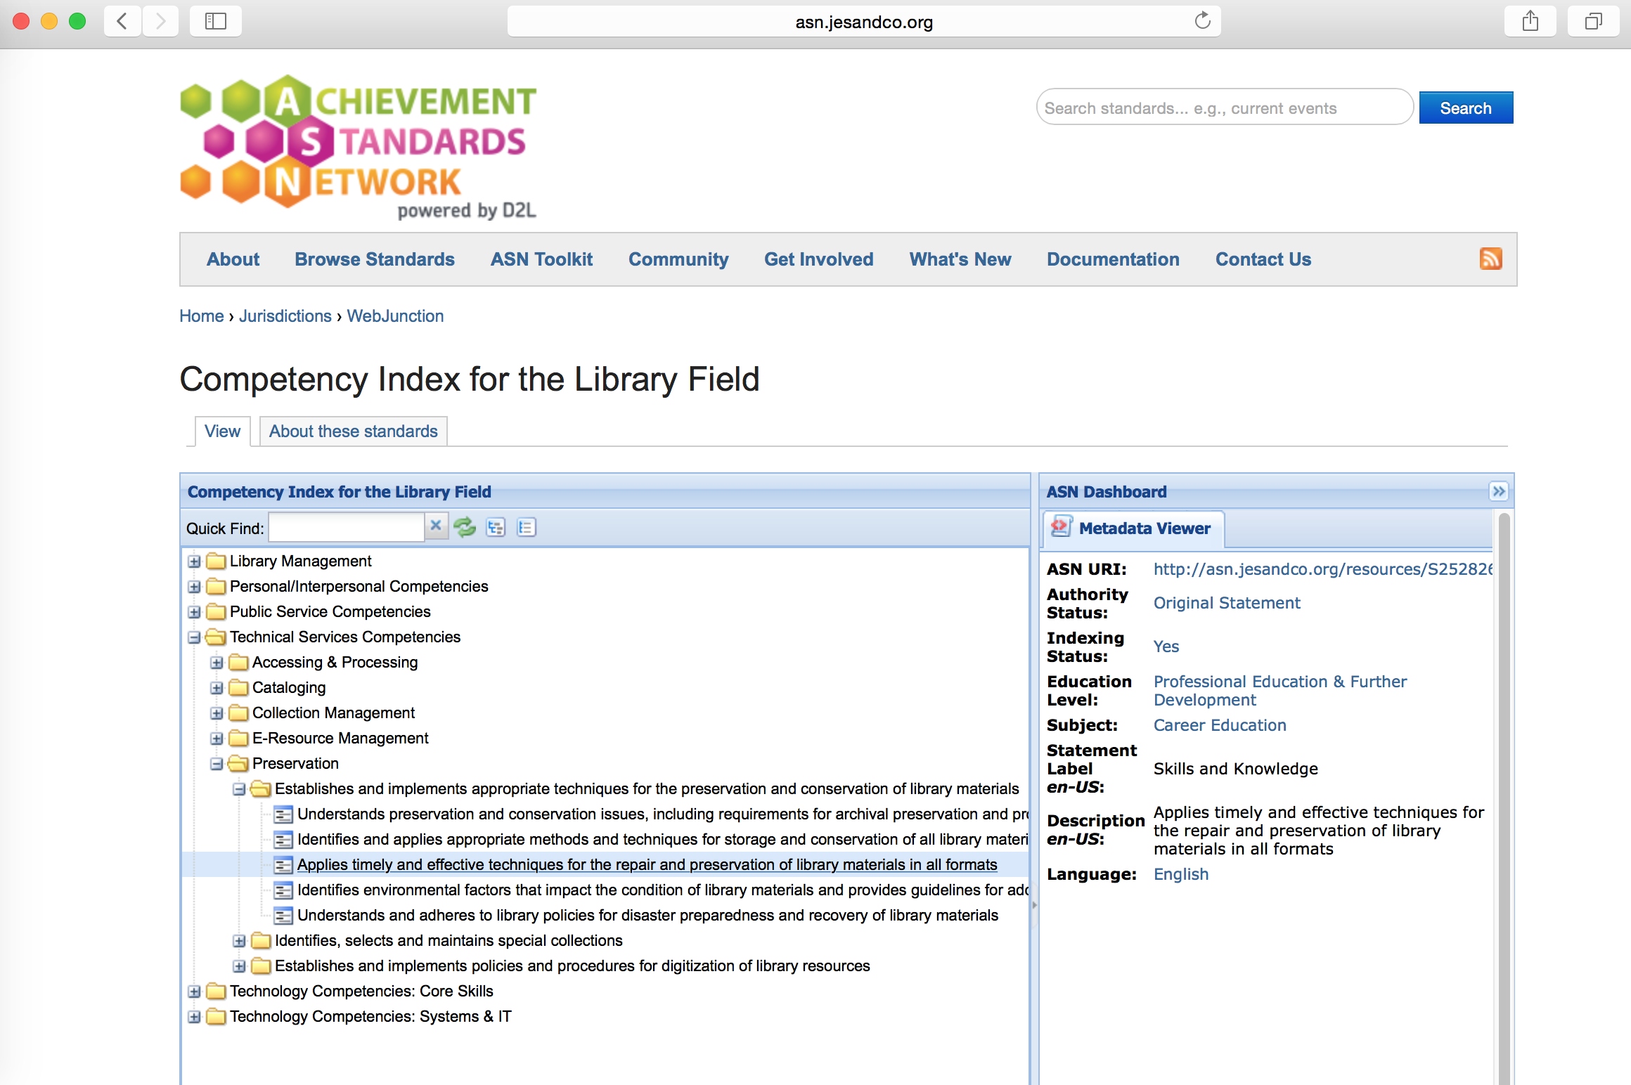

Slide 21
Competency Frameworks for Audiovisual Archiving?
Unesco’s Curriculum Development for Training of Personnel in Moving Image and Sound Archives (1990)
Edmondson’s Philosophy of AV Archiving (2004)
Clusters competencies by types of positions: top management, middle management, and skilled workers;
Top management includes heads of acquisition, cataloguing, documentation , technical services, library, publications, education/exhibition, public relations, and administration.
All top management requires extensive knowledge of the history of film, video, broadcasting, the technical processes and feasible audiovisual recording modes, as well as a thorough knowledge of general history.
Other knowledge may be more specialized, depending on job duties.
“There are broad areas of knowledge which could be considered as ‘basic equipment’ for all audiovisual archivists, whether acquired formally or informally. These include:
The history of the audiovisual media
Knowledge of the recording technologies of the various audiovisual media
Collection management strategies and policies
Technological basis for preservation and access
The history of audiovisual archiving
Basic media-related physics and chemistry
An understanding of contemporary history”

Slide 22
Benefits of Developing Competency Frameworks
Competency frameworks can often help us address equally all three domains of learning, whereas learning objectives may focus primarily on the cognitive domain (i.e., the subject matter of a particular course, or a program of study).
Frameworks can help us integrate a variety of learning opportunities, not just classroom experiences, into our programs.
Frameworks can help us work holistically, producing graduates who are more prepared to step into professional environments and achieve success in their chosen field.

Slide 23
Benefits to Competency Framework Development (cont.)
A competency framework that recognizes achievement at multiple career stages can help educators focus on transmission and acquisition of skills and knowledge for both graduate education and continuing education.
Students will have more confidence in their ability to step into professional settings and meet or exceed expectations for job performance.
Framework development and assessment that actively engage practitioners/employers will improve relations between academic programs and the profession and improve learning outcomes.

Slide 24
Barriers to Competency Framework Development
Perception that developing competencies means the ‘dumbing-down’ of education;
Perception that developing competencies will mean catering to specific job requirements or expectations of particular employers;
Perception that competencies are set in stone and not flexible enough to accommodate different ways of thinking or interpretation;
Lack of interest/motivation to work collaboratively (perceived benefits are not compelling enough to warrant the work that goes into program-wide or field-wide competency framework development).

Slide 25
Ways to Break Down Barriers
Create competencies that are not tied to particular technologies or systems, and that emphasize the application of knowledge to multiple situations and environments;
Build communities that engage all stakeholders, including educators, practitioners/employers, and students so that all interests are equally represented in the competency development process;
Commit to regular reconsideration and revision of competencies that acknowledges and incorporates new knowledge and innovations so that competencies retain relevance.

Slide 26
Steps In Competency Framework Development for Programs or Fields
Prepare, by defining the purpose of the framework and gathering a team that will develop it (including people that do the work—like practitioners!)
Collect information about relevant competencies through a variety of data collection techniques (literature reviews, reviews of syllabi and other instructional material, analysis of employment advertisements, surveys, observations, interviews/focus groups, etc.)
Build the framework by grouping the competency statements, creating and refining subgroups, and identifying and naming the competencies.
Implement the framework—by using it as the starting point for developing and revising courses or programs, and relating course-specific learning objectives to program-wide competencies.

Slide 27
AV Competency Framework Working Group, Current Members
Snowden Becker, UCLA
Edward Benoit, Louisiana State University
Janet Ceja, Simmons College
Karen Gracy, Kent State University
Asen Ivanov, University of Toronto
Lindsay Mattock, University of Iowa
Brian Real, University of Maryland
Ciaran Trace, UT Austin

Slide 28
Thank You for Listening!
More questions/comments?
Want to join the working group on developing a competency framework for audiovisual archiving/preservation?
Please contact me at:
kgracy@kent.edu
Notes:
AMIA 2015 at Portland, Oregon

