Slide 1
Virtual Engagement: Archival Participation in Social Media Platforms
Ariel Schudson, Access Committee Chair
#AMIA15
#SocialMedia
#AMIAAOU
Instagram/Twitter: @archivistariel
Email: ArchivistAriel@gmail.com

Slide 3
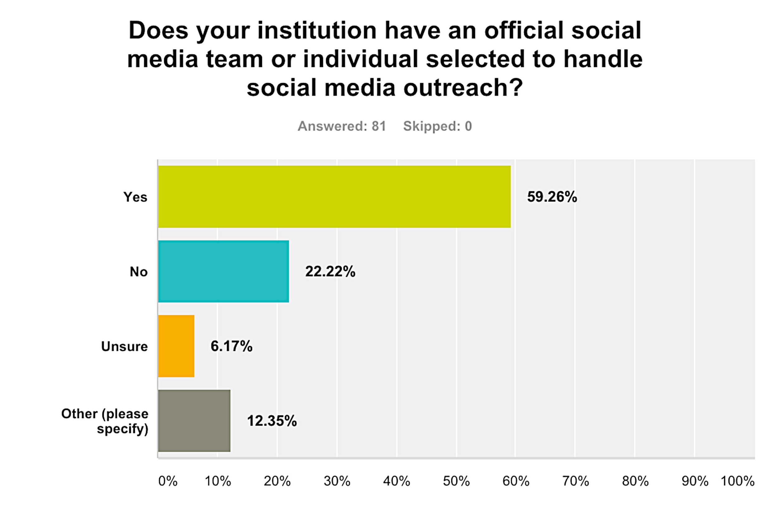

Slide 4
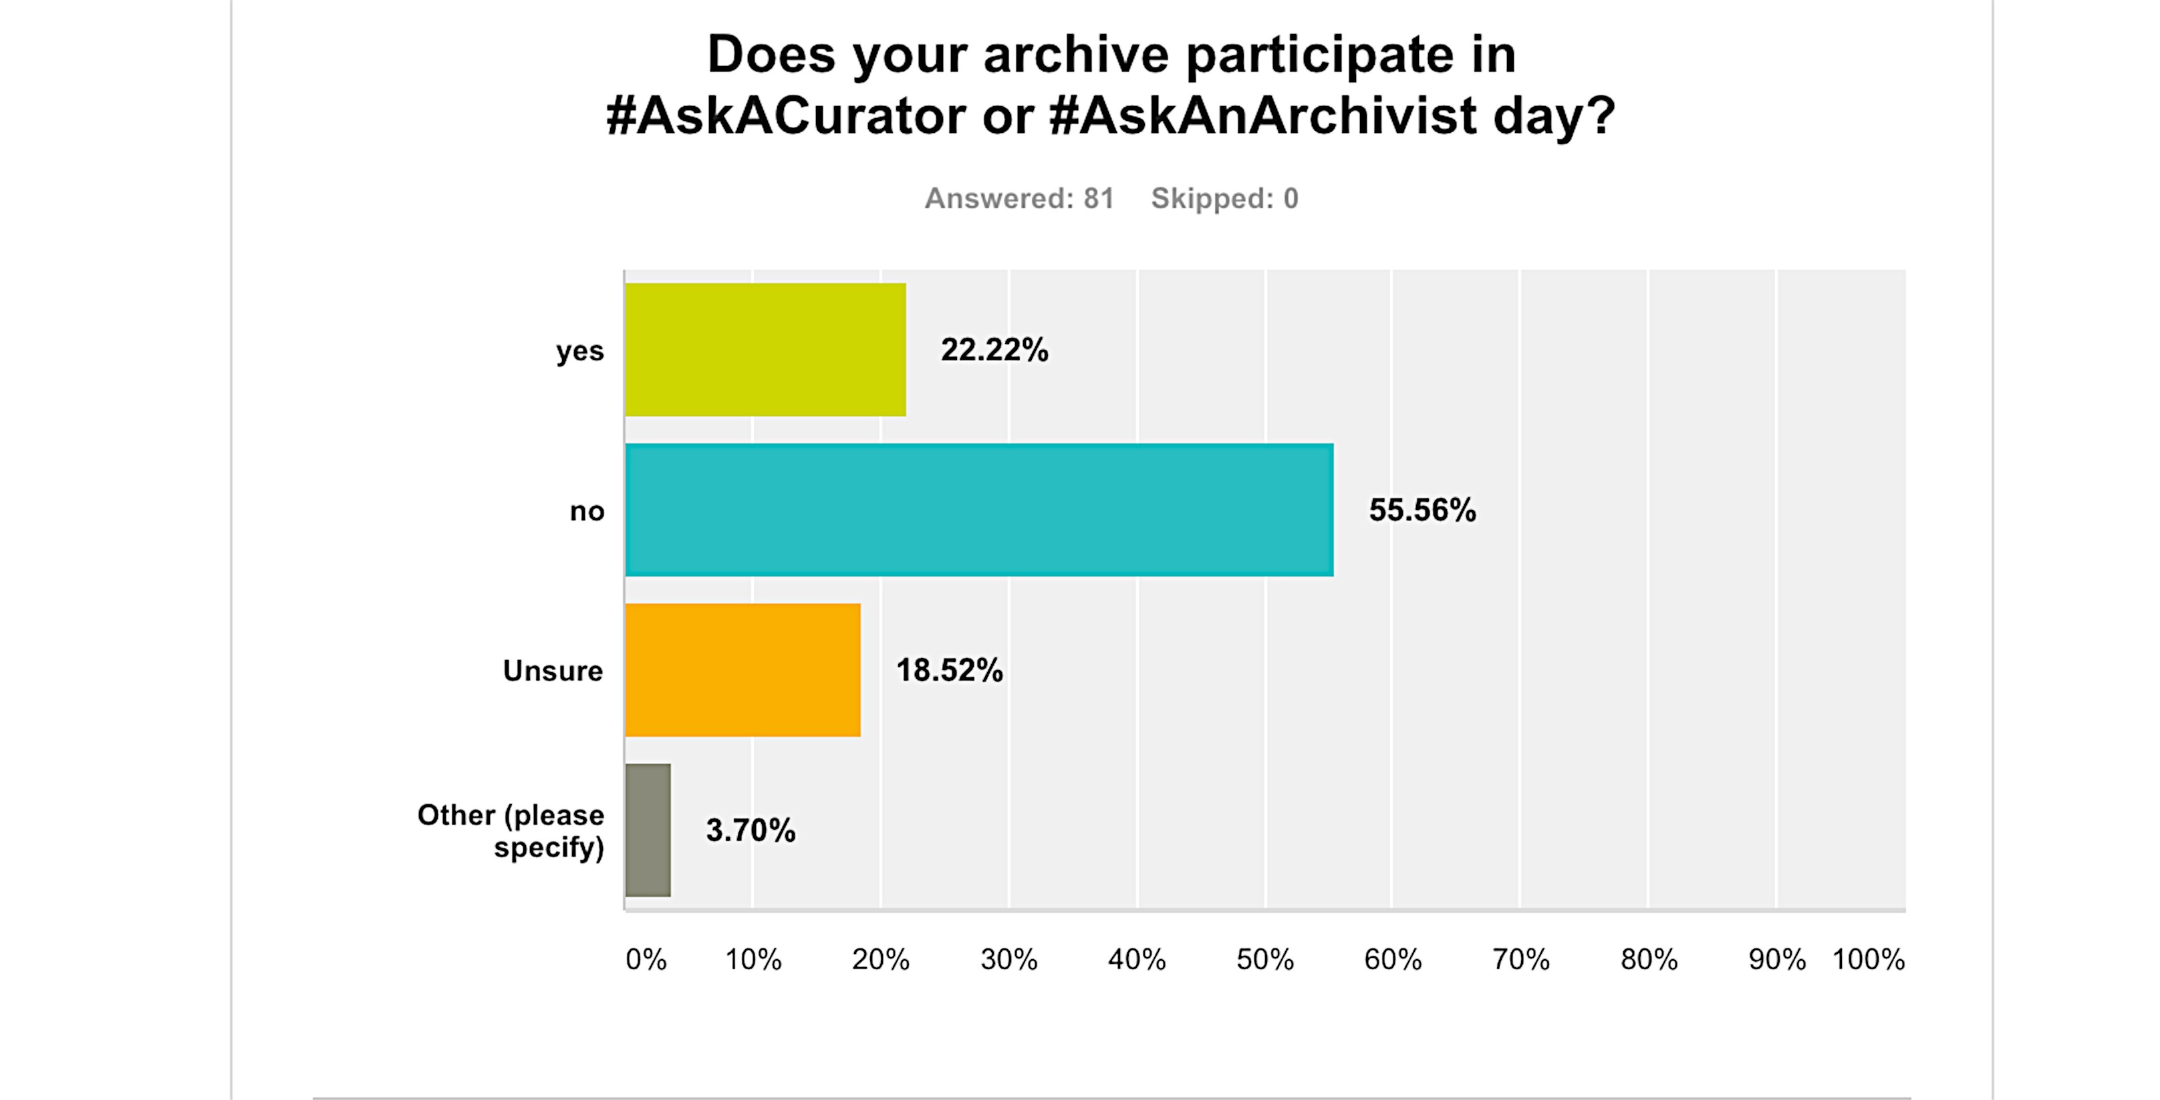

Slide 5
Twitter
SAA – interactivity and participatory! You don’t have to be there to participate - #AMIA15? Are we doing this right now?
FILM TWITTER- feed the hungry masses! You will incur *more* hungry masses! They are like Audrey Two from LITTLE SHOP OF HORRORS!
TCM Film Fest - #TCMFF was trending for the first time ever last year! In a Kardashian/Bieber landscape! SUCCESS!

Slide 6
Shake Your Moneymaker…Online
Archives are in constant need of funding & sometimes have fundraisers
People are constantly curious about what archives/archivists do
Preservation without access is pointless, but we need to start to reconsider ACCESS, newer audiences, and what they might be interested in – monetization is possible!

