Slide 1
Digital Preservation for the Rest of Us
Adapting Best Practices and Building a DigiPres Program at Penn State

Slide 2
Accidentally on Purpose
Reality
Condensation
Shopping
Invitation
Notes:
Johnny cash
The archival video digitization focus then, and still is, mostly concerned with signal processing. output formats, codecs, wrappers, storage, accessibility, copyrights, etc etc, etc. The methods and outputs of the digitization process are still debated but at least they are defined.
We at penn state wanted to join in that everlasting debate of methods and outputs. We wanted to preserve and make our collections accessible, but in the beginning we couldn’t even make a digital preservation file to argue about!
We had to take the first step, even if it was a misstep, we had to come to the preservation table with some firsthand experiences. We wanted to adhere to archival practices, but we felt that continued debate without practice wasn’t beneficial to the materials---- inaction because of debate wasn’t a viable excuse. Making the content and the message in our films and videos accessible to patrons in the distant future was as important, or maybe more important, as deciding what brand of equipment to buy, or what codec to use, etc.
Sometimes we felt like we were on our own and that everything we could do would be just laughed at by others. Don’t feel this way! There are a lot of “you” out there facing the same decisions.
Reality
Not a discussion of standards or a debate about best practices. There’s a reality that exists locally that might conflict with another institution. The idea here is to find the intersection of local reality and archival best practices.
Condensation
Condensing a lot of research into something usable and realistic for organizations with limited budgets and resources. I really want this to be useful, or at least provoke a useful discussion about what we’ve learned throughout our process.
This will illustrate some of the pitfalls and realities you face along the way- you will, at some point, drown in specifications, opinions, and data. Our decisions were based on quite frankly a lot of internet research, reading, reading, reading, 1000s of google searches, more reading,,
Shopping
not a debate on the best equipment, just the basic setup, or what you really need if resources are limited, the essentials based on your local resources and wishes
Invitation
By presenting our program we invite critique, we want to learn more about things we missed or what we really should be doing that we are not doing, learning new methods and outputs that are feasible is exciting and you only learn these things by being flexible and adaptable in your preservation approach

Slide 3
Another Year: A Short History of Almost Something
Penn State University Libraries’ Strategic Plan 2014-2019 goal:
“describe and digitize all distinctive and unique collections, with particular emphasis on at-risk formats like audio and video, and holdings in Special Collections….”
2011-Present
Programmatic and practical transformation
Over 300 videos and films digitized
Notes:
Amanda palmer
The Penn State University Special Collections Library consists of several curatorial areas, each with their own AV materials within their respective archival collections.
Film and video collections have over 25000 titles. Assessment work is ongoing and probably the next best are to focus our resources on. We have limited resources for digitization, so assessing the collections and prioritization are a crucial part to optimizing your resources
Prior to our current preservation program we only had a small collection of video playback machines, and a DVD recorder. Film viewing was only possible through an aging Cinescan machine, digital copies of films were all outsourced. Patrons or staff had no way to view content on film.
A comprehensive change from reformatting to optical disc to file based digitization was clearly the best path towards greater access, delivery, and conservation.
Digitization in-house is primarily focused on fulfilling patron requests and contributing to exhibits, special programming, and online content for promotion

Slide 4
Another Year: A Short History of Almost Something
Format | Number of holdings
16 mm film | 8,660
Videotape (including Betacam, ¾” Umatic, VHS, DVCPRO, DVCAM, miniDV) | 17,500
DVD | 6,150
Notes:
Amanda palmer
Film and video collections have over 30000 titles. Assessment work is ongoing and probably the next best are to focus our resources on. We have limited resources for digitization, so assessing the collections and prioritization are a crucial part to optimizing your resources

Slide 5
Building the Mystery
Notes:
Sarah mclaughlin
The following will illustrate our current setup and provide some insight on what equipment and resources are needed.
Even with money to spend, what do we spend it on?
I want to remind everyone that each part of the digitization for preservation workflow is equally important, spending money on equipment is also dependent on staffing, storage space for digital files, etc.

Slide 6
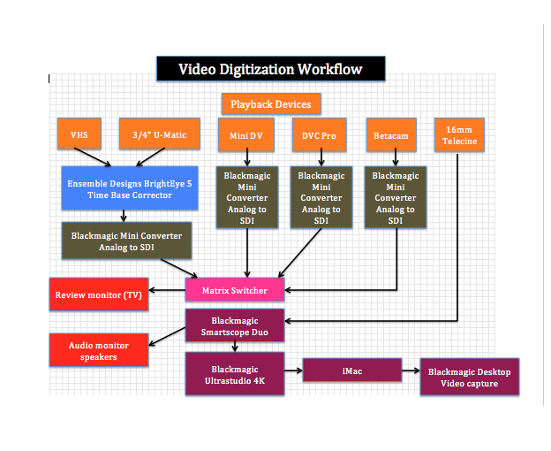
Notes:
Explain diagram, playback equipment and digitization chain

Slide 8
METADATA
Unique file name
Dublin Core scheme
Notes:
Something we struggled with early on, don’t become so enamored with creating digital files for preservation that you forget that part of preservation is describing accurately for future patrons and researchers what it is that they are viewing

Slide 9
STORAGE???
Notes:
Another debate, another expense. Again, crucial part of the digital preservation workflow, you waste resources if all you do is create a mountain of digital files and ulitmately put those files at risk because of lack of adequate archival storage.

Slide 10
Decision time
Assessment
Data
Resources
Formats
Notes:
Assessment based on data- format type, condition of materials, research value, rarity, AND what is combination of those factors at your institution- for example you might have commonly held items but with high research value to your patrons, or at risk formats regardless of value and uniqueness
Decide what is most important at your institution and then build your program based on resources. Maybe it’s just one format, or one collection- point is, make a decision based on data and anecdotal evidence and start there. But start. Spending time and resources worrying about every little thing you read or hear about can impede progress. Example, you have a large collection of locally important VHS tapes- buy the best VHS player you can, direct the output to an appropriate converter, capture the video signal. You learn by trying, not everything will always be the best, but you constantly evolve and adapt your practices over time and based on your resources at your institution

Slide 11
Ways and Means
Equipment
Local TV or public broadcasting station
Ebay
BroadcastStore
On campus media departments
Notes:
Snow patrol
Finding equipment

Slide 12
Ways and Means
Information resources
Colleagues at peer institutions
Manufacturer support- equipment, software, etc
Industry experts
Notes:
Snow patrol
Colleagues- You have to find a sympathetic ear as well as a critical ear. Doesn’t help to only listen to criticism of your proposed program and it doesn’t help to only listen to others who are not activley seeking a solution
Mfgr support- take advantage of what they offer, ask them questions, explain what you are doing or attempting to do, by explaining you solidify your own internal decision making process---after all you’re buying their products!
Industry experts- often could be the most critical but use their opinions and expertise to find a happy medium, asking the manufacturers will give you the possibility of something “technically” being possible (i.e yes it is possible to do x with y) , asking the experts in the field will give you an idea of what is professionally accurate and considered an acceptable best practice.

Slide 13
Thank you! Questions/Comments trb157@psu.edu

