Slide 1
verifymedia – checking the technical specifications of files with a script (and what I learned along the way)
Kristin Lipska
November 11, 2016
AMIA 2016 - Pittsburgh
Notes:
Kristin from California Audiovisual Preservation Project (CAVPP).
CAVPP works with libraries and archives across the state to digitize and provide access to California’s AV history. We outsource the digitization to vendors so part of our job involves doing quality control on the files that we get back. One step in the QC process is confirming that the files meet the prescribed technical specifications.
CAVPP has a script, called verifymedia, that we use to check the technical specs of files from the digitization vendor. I’m going to talk a little bit about how we came to commission the script, and how working with the developer helped me to get familiar with some basic but increasingly essential technology tools; and then I will demonstrate the script.

Slide 2
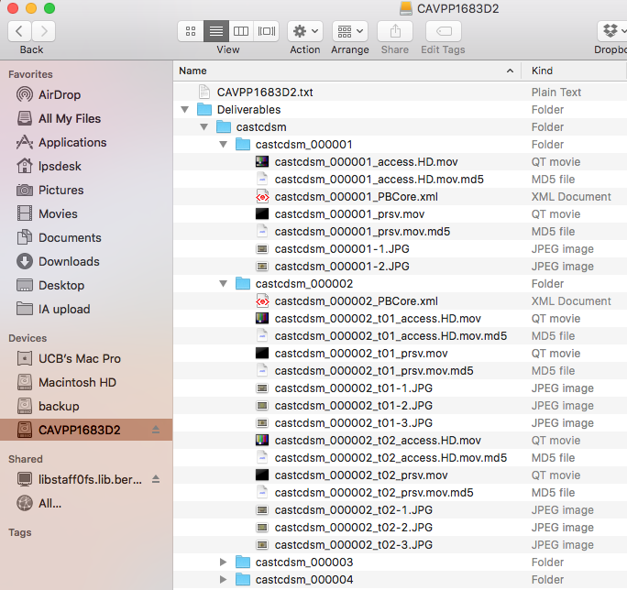
File structure
Notes:
To briefly orient you, here is an example of how the files come back from the vendor. Files are grouped by partner institution. All files for an object are in a folder together, and we have preservation and access file states for each recording.

Slide 3
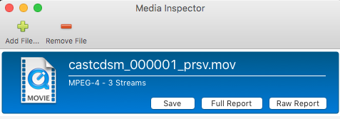
Checking tech specs manually
Notes:
Initially we were checking technical specs by using mediainfo or media inspector to display the technical metadata and then visually scanning to make sure it matched our specifications.
Here, our target specs are on the left, the video preservation specs are highlighted, and on the right media inspector displays the technical metadata for a video preservation file.
This process takes time and clearly it is possible to miss things this way.

Slide 4
MDQC Tool
https://www.avpreserve.com/tools/mdqc/
Templates for:
Video Preservation
Video Access
Audio Preservation
Audio Access
Notes:
At some point I heard about a free tool for automatically checking technical specs, MDQC.
It allows you to set up different templates. I tried it out setting up four templates for our four file types, but in testing the templates against our files, I found we would also need separate templates for videos with and without an audio track, and for stereo and mono audio files. Otherwise a video without an audio track, for example, would fail the check against a template looking for certain audio specifications.

Slide 5
MDQC Tool
https://www.avpreserve.com/tools/mdqc/
Templates for:
Video Preservation Sound
Video Preservation Silent
Video Access Sound
Video Access Silent
Audio Preservation Stereo
Audio Preservation Mono
Audio Access Stereo
Audio Access Mono
Notes:
We would need 8 templates, plus we don’t know which files need which templates by looking at the directory.
If we were not a collaborative project we might have asked the vendor to reorganize our file structure to sort files by technical qualities, but since we work with so many institutions, it is more useful for us to organize files by partner.
So we didn’t add MDQC to our workflow but exploring it as an option gave us the idea that we might be able to create a script to automatically check our technical specs.

Slide 6
Let’s make a script!
Learning about:
Github
Homebrew
Bash / Shell
Notes:
We asked our colleague Dave Rice if he could write a script for us. I ended up as the manager of this project, I think primarily because I had the most interest in using scripts and similar tools, but not because I had any prior skills in this area.
Working with Dave, testing and providing feedback allowed me to get familiar with a few basic technology tools, which has improved my confidence and interest in using and sharing these tools, and in investigating other ways we might be able to automate parts of our workflow.

Slide 7
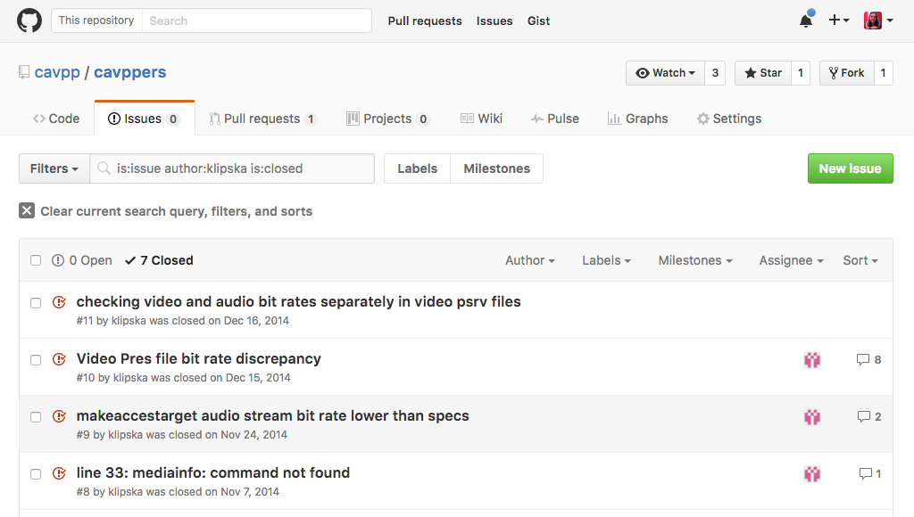
Github
CAVPP repositories: https://github.com/cavpp/
Report and track issues:
Notes:
First up is Github. When Dave started creating scripts for us he suggested we setup an organizational Github account for CAVPP. On Github we can store all code and scripts related to the project and our code is open and available to others. It also allows us to collaborate with developers by making it easy to report and track issues. Issues can be assigned to certain people.
Here is the history of issues reported for this repository. They have all been marked as closed since they have been resolved.

Slide 8
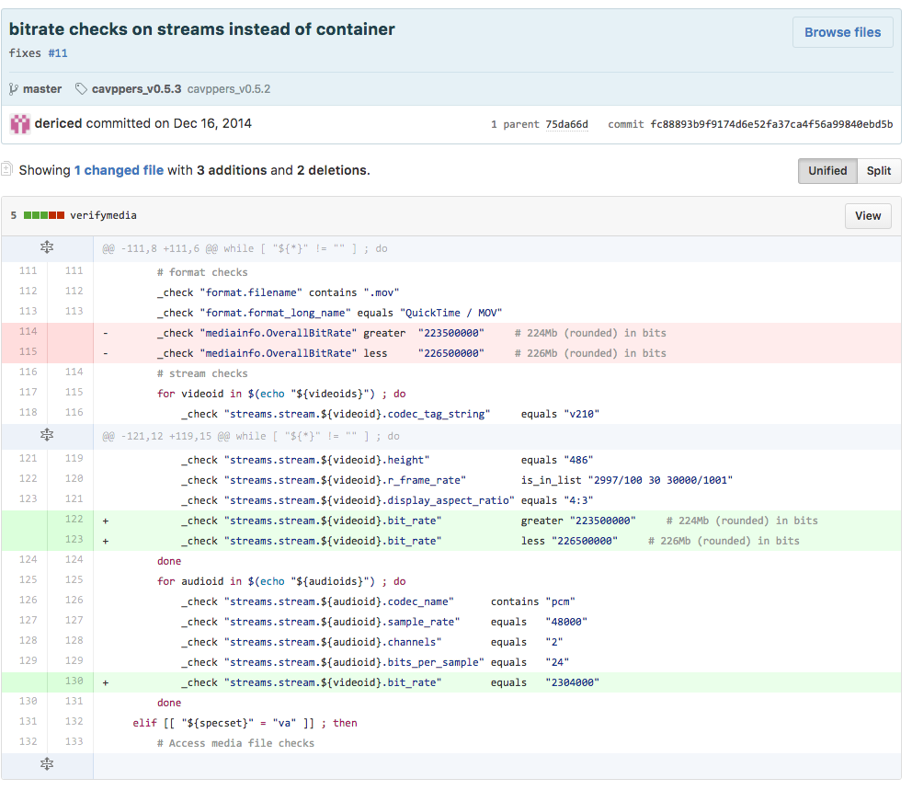
Github
Track changes to script:
Notes:
Github also tracks changes and prompts the editor to provide a description of the changes made, so the modification is clear even if you don’t read code.
In this example the change was to do “bitrate checks on streams instead of container”.

Slide 9
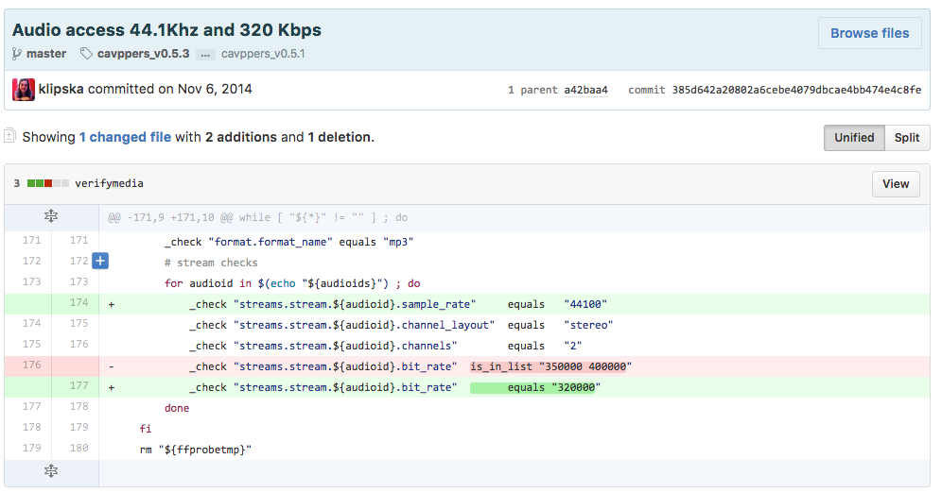
Github
Making changes:
Notes:
With this particular script, which mainly just lists technical specs to check for, it’s fairly easy to see what is going on, and I eventually was able to edit the specs myself directly on github. In testing the script with our files I might see that something wasn’t being checked or was checking for the wrong metric. I was able to copy the format of another similar check in the script and adjust the settings.
I this example I added a line to check that the sample rate of the audio access files is 44.1 kHz, and I adjusted the streaming bit rate the script is looking for.
I’m mentioning this to let you know that this script is available and could easily be forked to your own github account and adjusted to check for your institution’s file specifications.

Slide 10
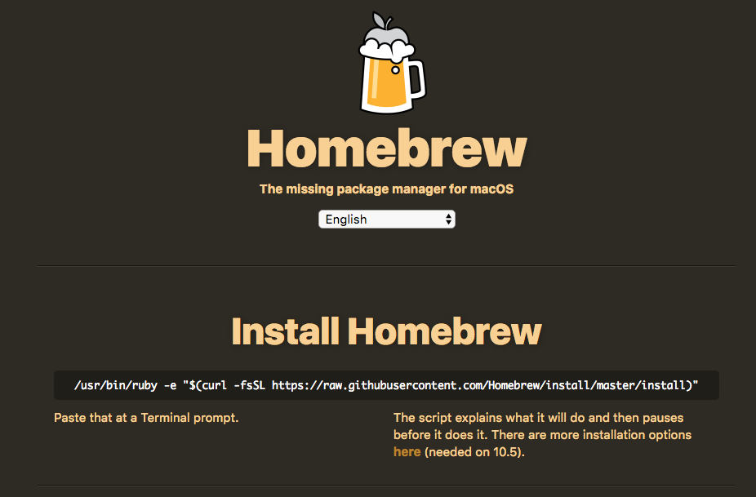
Homebrew
http://brew.sh/
Notes:
Dave also asked us to download Homebrew which is used to install and update the script by pulling the current version from github.
I’ve found Homebrew to be pretty user friendly. This is the website which clearly tells you at the top of the homepage how to install homebrew by copy and pasting this text into Terminal.

Slide 11
Homebrew
http://brew.sh/
To Install CAVPPers:
brew tap cavpp/cavpp
brew update
brew install cavppers
To Update after changes have been made:
brew update
brew upgrade
To diagnose:
brew doctor
Notes:
I now know the basic install and update commands. Of course in the process of trying to get these scripts installed on all the computers in the office I encountered errors. Over time I’ve learned some rudimentary troubleshooting skills from sending errors to Dave and seeing his responses.
Homebrew is very helpful in this regard. The ‘brew doctor’ command checks and reports if anything is wrong. The error messages also often include suggested commands that might fix the problem. So I’ll try the suggestions and I’m sometimes able to fix things this way without help.

Slide 12
Bash / Shell
verifymedia commands:
Video Preservation: verifymedia -s vp –v
Video Access: verifymedia -s va –v
Audio Preservation: verifymedia -s ap –v
Audio Access: verifymedia -s aa –v
then drag in files to be checked.
Notes:
Last I want to mention the shell, which is available on Macs through the Terminal program. I’d used the command line to run other scripts, but hadn’t really used many shell commands.
Using this script and others I started to learn the syntax, which I’ve found usually takes the form of the basic command, then modifiers preceded by a dash, and then the path to the target files or folder.
For this script, first we have the name of the script, then –s allows us to select one of the four profiles, and –v selects verbose mode which displays what was done – in this case the specs checked and their values.

Slide 13
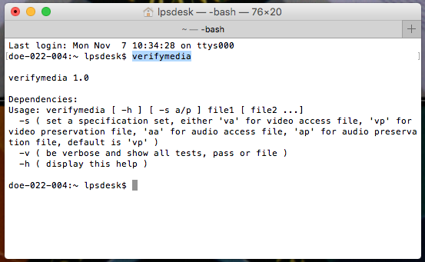
Bash / Shell
Command options:
Notes:
One helpful thing to know is that typing the name of the command will show available options. Here I’ve typed verifymedia and it shows me the available modifiers.
Shell is powerful tool for finding moving and copying files among other things.
Recently I’ve determined we can use it to find all the access and PBCore files on a drive and move them to the upload folder where they need to be for the batch upload to Internet Archive script. This sounds like a small thing but is actually a big time-saver over manually finding and moving the files in Finder, especially when is is a big batch.

Slide 14
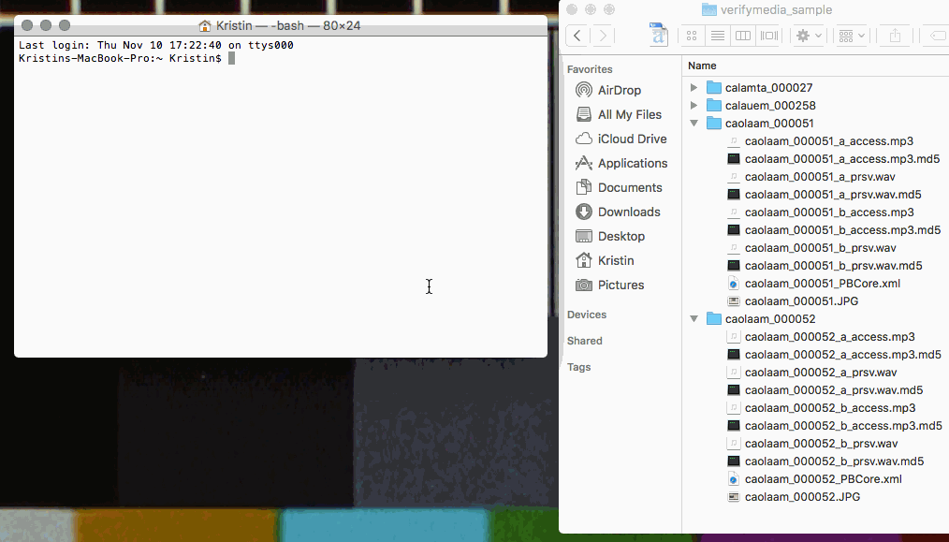
Script demo - pass
Notes:
Recorded demonstration verifymedia script.
Audio access:
verifymedia –s aa –v
Green = good

Slide 15
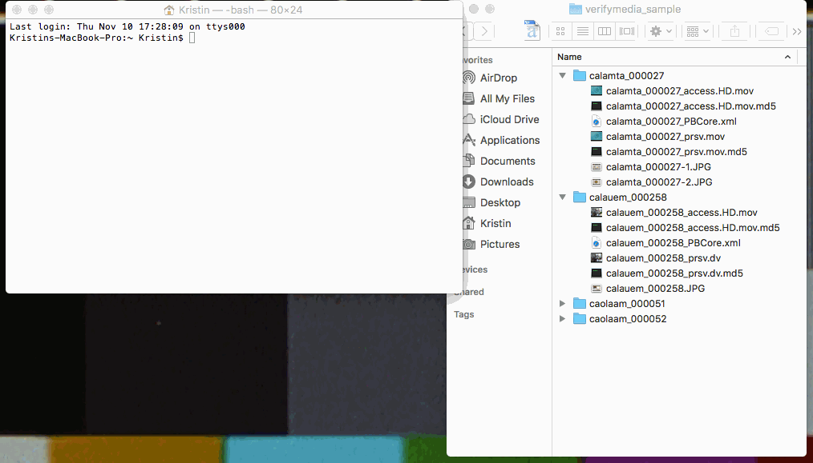
Script demo - fail
Notes:
We can also see how it looks when something fails:
Video preservation:
verifymedia –s vp –v
Red = failed
For digital sources we ask the vendor to keep the original digital source as the preservation file. In this case it is a .dv so it doesn’t have our usual preservation specs.
Works with 4 profiles:
With this script, if a video file has an audio track the script checks the audio specs, but if it does not have an audio track, the verification does not fail.
For audio files the script checks for stereo specs. If the specs are mono it will fail, but verbose mode allows us to see the failed specs and check that they are correct for mono. The failure also prompts us to confirm that the source is in fact mono.

Slide 16
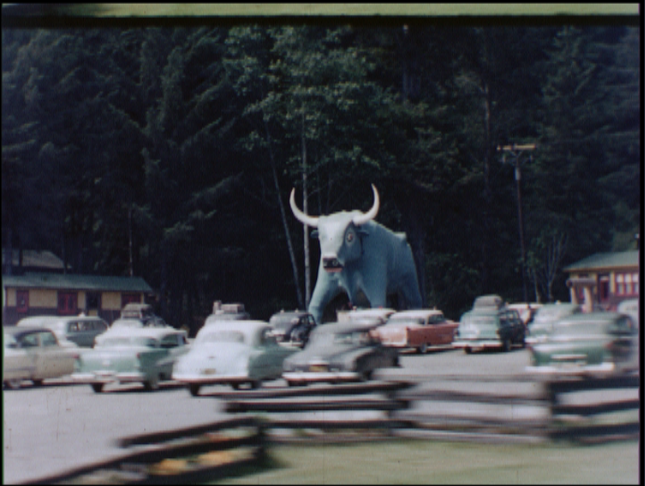
klipska@berkeley.edu https://github.com/cavpp/
californialightandsound.org
Notes:
contact

