Slide 1
Born-digital camera-original video
Practices and Risks

Slide 2
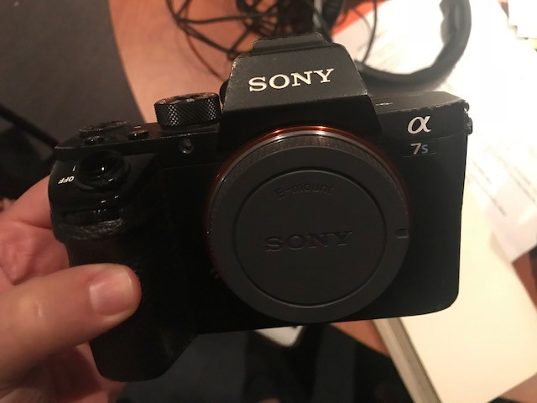
The Need
Toward a Risk Assessment Model for Born-Digital Camera-Original formats
Documentation of cameras and their resultant files
Identification of significant properties of common and emerging BDCO formats to inform best practices
Sony A7S2- recording format options: XAVC-S (4K & HD)/MP4; AVCHD; MP4
Notes:
This project was born out of our effort to build workflows with video producers at the Smithsonian. In preparation for archiving productions in the Smithsonian's Digital Asset Management System, we surveyed many video producers to learn about their production practices. You’ll hear more about the survey in a moment, but for us it really highlighted the need to develop a risk-assessment approach to analyze specific, common, born-digital, camera original video formats and make decisions on which file formats to retain and support as an Institution.
We believe that current file format sustainability factors and risk analysis/mitigation documentation in the field of video preservation falls short when it comes to born-digital formats – we have great documentation of target file formats when digitizing from analog, but there is no equivalent for born-digital, camera original formats. While there are many different codecs out there, we are seeing consistency in the formats being created at SI and we’re at a point where we need to start making decisions on best practices for file retention/potential normalization or remuxing for long term storage and access. We also know that new cameras will come out every year with different specs and output capabilities, so these formats may evolve over time, and we need a set of best practices that will help us to navigate that.
So - In hopes of working toward that set of best practices, whatever it may end up looking like, we have begun documenting what we see at the Smithsonian, including the cameras in use at SI and the formats they create, as well as the formats we are seeing from producers and the significant properties/file variations/potential risks that we see with each of those formats.
Our goal with this talk – and the project in general – is to open this analysis of common born-digital camera original formats to the field and encourage others to participate in documentation of format specifics through shared and open documentation. This collaborative documentation is currently in a google doc, which we will show you in a few minutes, and we are asking the membership of AMIA to contribute to this by adding information about files they see and work with (because we know production practices are not the same everywhere!). Our hope is to create a resource that allows us to be proactive in planning for archival and preservation actions for these types of files.
So basically, we’re here to ask for your help in this documentation effort!

Slide 3
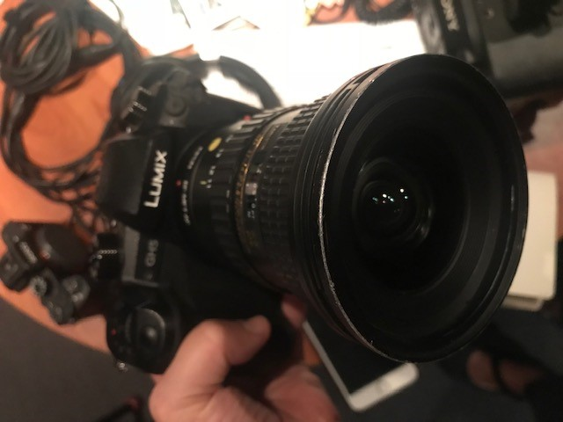
The Survey
A variety of cameras used- but mostly a common set of prosumer cameras from just a few major companies.
Native camera-originals become high resolution masters for the archive.
Time and resource constraints lead to non-friendly archival workflows for edited masters.
Speaking different languages.
Panasonic Lumix GH 4/5- MP4/LPCM
Notes:
At the Smithsonian, the Institution is made up of 19 museums, various research centers, archives, libraries, and the National Zoo – or over 30 different organizations under one roof. The Institution has built strong policies on workflows and preservation formats for images and audio, with a host of supported trainings and tools. As you can imagine, each unit, as we call them, has developed variations in these institutional standards according to their own collections, resources, organizational structure, histories, tools, etc. One example- for digitizing video, all three major preservation formats are used for various reasons. When we talk about video originating in digital file form, we get even more variations. The Smithsonian has begun to actively acquire and produce digital video- with all the necessary consequences or storage, archiving, access, and retrieval. Taylor and I work on a central digital repository, storing and preserving files from across all the units, so We find ourselves not only grappling with a variety of digital video formats, but also being asked by contract producers, donors, researchers, etc. what kind of video we prefer. And up until now, our answer has largely been- it depends.It depends on what cameras are you using? Are you editing? What tools are you using? What are your output options? Etc etc. This conversation is very different with video producers creating content for the Smithsonian American Art Museum on Interviews with Video Game Creators, vs with Contract producers in Tibet documenting rural cultures for the Smithsonian Folklife Center and Cultural Heritage.
Really, most of the time, you just get what people give you.
So, we set out to find out themes in current practices across the Institution’s video producers. In two sessions in April of this year, we heard from 16 participants from 11 units. Questions asked include:
What Video production tools, cameras, etc. do you use?
What files do you use to edit with? Do you transcode edit masters or use files off camera?
What Editing tools do you use? What files do you create for your edit masters?
What files do you keep? Do you normalize- ie output and keep the same file format for each project? Do you keep your camera originals?
Do you record project data? Where?
Do you embed data into files? Or change file names? Have a file naming convention?
Where do you store your files?
How do you provide access? What platforms?
Most pressing goals/needs in this area?
We pulled some themes out of the notes- and some of them we weren’t too surprised by
More and more content is shot in 4k, and it is still used selectively- say for oral histories or gallery documentation, but not for lectures or event documentation. Not always consistent in that way but there are decisions being made on content
Editing suites that are used are predominately Adobe products- some final cut.
Storage is mostly on local drives with copies made
Various delivery platforms were used mostly youtube and vimeo- happy with built in audiences.
Metadata mostly kept in directory names were files are held- some excel.
Transcription largely outsourced our done by hand- great need
Few established guidelines in working with contract producers on delivery needs.
Not a lot of rights discussed- not systematically dealt with..
And some that were more illuminating to us- mostly that
A variety of cameras are used- mostly the producers were mentioning the same camreas- mostly prosumer and from just a few major companies. Most common practices is to keep camera originals as native format off camera as the master raw footage. Producers select and weed out at this time so that most of this raw footage is important, kept, and expected to go back to- very rare transcoding off card to normalize for editing now that editing suites don’t demand this.. High res master footage is stored in camera original native file formats.
Most common practice is to export out edited derivative of the version needed for delivery (low res for social media, websites, etc). exporting out high res edited versions takes a lot of time so this is not systematic.
1. We did not have a shared language at all- I ask them about what type of files they make and they might say the Lumix makes mp4 or the GoPro makes mov. I think sometimes, as trained video preservationists, we are learning to talk about video codecs and file formats and producers speak in cameras and output option labels, and we didn’t have a bridge between us.
2. We started a few projects of the succeeding months that we think respond to the challenges we think we will see-
3. Formalizing digital processing workspaces- with retention schedules and easy hand off to archives/processing/collections staff.
4. The sketching out of workflows and tools of support for easy archive to delivery platforms- like we do for images- to integrate systems and hopefully encourage the creation of high res masters of edited finals.
We anticipate eventually our legacy born digital collections will come to our central repository as a variety of camera original formats. So, what do we do with this? With our scale- it depends is no longer an appropriate answer- but we are also not in a position to normalize everything to one preservation format- also I would ask – is that even a good idea? Started to think of a middle- in between keep whatever we get, and normalize everything.

Slide 4
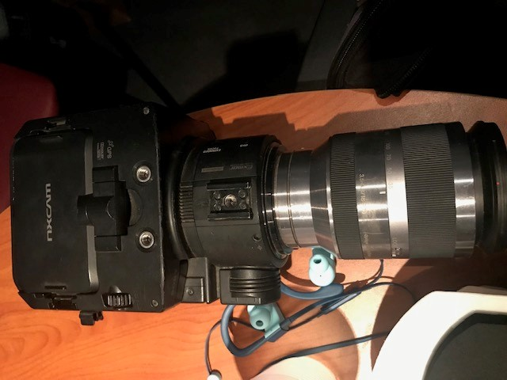
The Trends at SI
Commonly produced born digital formats
ProRes
AVCHD
AVC, XAVC
Video currently in the SI DAMS
Of the 43,760+ video files in the DAMS,
90.4% is wrapped in quicktime or mpeg
ProRes 422
ProRes 422 HQ
H.264
Sony FS100 NXCam- AVCHD
Notes:
So one of the things we’ve learned, from both the survey and from our active work with some of the larger video-producing units at SI, is that most of the video being produced is in ProRes, AVCHD, and now XAVC 4K formats. So while there may be some variation in production practices, these are the main formats we are concerned with at the moment.
Using CFCH as out example here (since we have worked most closely with them), we’ve also seen that the digital formats being produced really don’t change as rapidly as we tend to think. Over the last 4 years we’ve worked really closely with the video producers and archivists during the Folklife Festival to archive the festival documentation video in the DAMS. They produce tons of content over the course of the festival, so we’ve developed workflows that insert the archive at the point of creation, so the archive gets copies of the files to prep for DAMS as they’re being created. We’ve gone from seeing about 80% AVCHD during the festival to now a flip of about 80% XAVC this past year, as the producers acquired more 4k cameras. So yes, there is a shift there, but the main formats we’re seeing are actually pretty consistent.
As Crystal mentioned, we do anticipate a large pile of files to be coming our way from producers down the road, things that are currently on drives and local storage. But to give a sense of what we already have in the SI DAMS, we ran some numbers last week (so these are certainly already out of date!) As of last week, we had 43,760 video files in the DAMS, and of those files, 90% are quicktime or mpeg wrapped files with ProRes and H.264 being the top codecs in use. Now these are not all necessarily born digital, but it is indicative that these are among the largest group of files we will need to focus on in general, and it’s telling that they are the same formats we’re seeing from the producers too. It’s almost comforting – seeing some consistency, and knowing that produced formats won’t change overnight.
To give a sense of scope, I checked with our DAMS team this morning and we are currently at 19.3M total files in the DAMS as of this morning! So the amount of video in the repository is still relatively little, but it is rapidly growing.

Slide 5
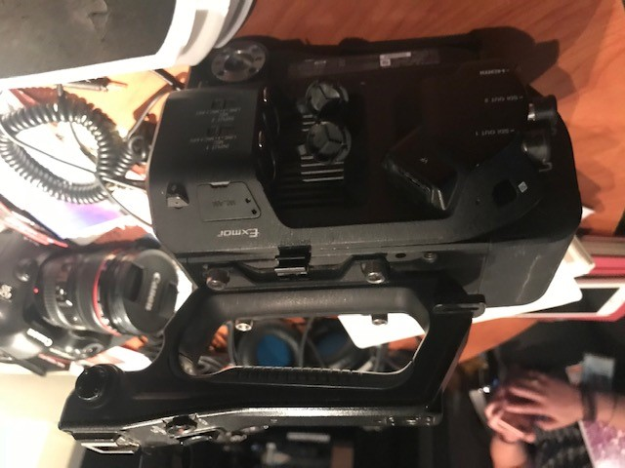
The Related Projects
FADGI – Creating and Archiving Born Digital Video
Intentionally High Level
Advice for File Archivists and File Creators
IASA-TC 06 Guidelines for the Preservation of Video Recordings
iPres 2018- Significant Significant Properties (R. van Veenendaal; P.C.M. Lucker; C.D. Sijtsma )
Others? We would love to know!
Sony FS7- XAVC-L/MXF
Notes:
Not only looked at what we had and what we anticipated getting, but we started to look around at the work that exists now-
FADGI 2014 project Creating and Archiving Born Digital Video outlines a set of high level recommended practices for creating and archiving born digital video with tools and case studies detailed from some federal agency participants- full disclosure, we were and are active participants in this group.
http://www.digitizationguidelines.gov/guidelines/video_bornDigital.html
This document has sections called Advice for File Creators and Advice for Archivists.
The shared advice- quote- “focuses on selecting sustainable encodings and wrappers whether at initial file creation or during normalization upon ingest.”
And it Includes sections like
2.5 Determine and document criteria for when (if ever) it is appropriate to change the video file’s technical properties (including normalization)
2.6 Retain the original video file as submitted if transcoding, normalizing or otherwise changing the video stream to meet business needs
2.7 Select appropriate technical characteristics for the video encoding if transcoding, normalizing or otherwise changing the video stream to meet business needs
doesn’t detail these but merely states that they should be attended to.
For us. With our scale, we discovered we needed more detail than just this high level advice- we cant always keep original copies- say when the collection is 5TB it has profound implications in resources.storage- what are these appropriate technical characteristics? Even our producers don’t have control over all the decisions of preservation- at the point of creation- even if they are interested- they are dependent on their tools- so we discovered we were looking for a middle- not just normalize everything- but how do we build a model of best practices for transformation or stabilization- not just normalizeation
We are excited for IASA’s TC-06 report IASA-TC 06 Guidelines for the Preservation of Video Recordings
Published this year in two phases-
Initial edition, publicly accessible in early 2018: focus on the preservation of video recordings on conventional carriers- or digitization of analogue videotapes
Expanded edition, planned for in 2019: discussion of the preservation of digital-file-based video formats and the transfer of digitally encoded recordings in videotape form (which may entail transcoding and/or rewrapping). Coming soon
Then at ipres this year, I was struck by a short paper, also three authors from National
Archives of the Netherlands, University of Amsterdam. Called
Significant Significant Properties
http://openpreservation.org/wp-content/uploads/2018/10/Significant-Significant-Properties.pdf
Also the winner of the popular award for posters- when people vote- they state “You need to be prepared to explain what significant properties are, and how you are going to identify and deal with them. No matter how mature your significant properties methodology is, it would be very useful to be able to bring a reusable, community best practice-based list of potential significant properties per information type with you, instead of starting from scratch every time.” You should check it out- they call these most significant of the properties- The table salt of the preservation world, as it were. For video- these include aspect ratio and frame rate, and color space and scan type. But still don’t yet distinguish between changeable properties in stabilizing/transcoding- like digital file size, and video codec.

Slide 6
The Spreadsheet
https://docs.google.com/spreadsheets/d/1OvZkGkizNnx_nZ9OVDOkJJIVFuIMK_7FYKC77YhoUac/edit
We gave everyone edit power so please be kind.
BUT please check it out/send us your additions/add comments/OR just add them in!
GOAL 1 - documentation of what we know
GOAL 2 - open it up to others who have different tools
GOAL 3 - work through shared terminology, common factors, and a risk assessment model that will allow institutions to build common actions
Formalize?
Add to LC Sustainability Factors with ‘Product Factors’ like Structure; Metadata Capabilties; Relational Decision Trees (streams; wrappers, etc.)
Notes:
--Go through our process of documentation – inspired by the LC sustainability factors, we have been documenting what we know about the formats we see the most - adding links to existing documentation of formats, documenting file variations, sustainability issues, and our own (very subjective) risk rating that is currently just based on our experiences with the formats we’ve been working with - - but we would love to work through this to eventually have a systematic, formalied risk assessment model (high, low, med- how did we get there?)
--We need to define significant properties to retain that will allow for rewrapping/muxing, transcoding without just normalizing everything in the same way – eventually working toward a relational decision tree for how to normalize/rewrap/or keep certain product types.
--We have had some comments and one additional row added!! Thanks to those who have already taken a look and contributed!
--(structure as a new group- adding this to the LC sustainability factors to assess risk?)

Slide 7
The Future (hopefully)
SI GUIDE
Product Type | Note on Structure | Sustainability Issues | Recommendation
AVCHD | Files are packed in an AVCHD -BVCHD directory structure; MTS files are split into 2GB chunks in a stream folder. | format highly dependent on retaining directory structure; only natively viewable on Mac OS; spanning clips can make audio drift if not done correctly; codecs predominant but MTS wrapper is not | Span clips, retain native AVC video streams; remux/rewrap to create individual files with a more sustainable wrapper
FADGI
Update Born Digital Video Recommendations with a focus on High Level Recommended Practices section with an eye to develop/document “significant properties” or “key technical characteristics” for digital video.
Notes:
Our goals-
Keep soliciting more info- we don’t see all the camera original formats- so we need others to contribute
Build an institutional guide that will list out what our video producers should do with various formats- like we do with images
We approached FADGI to see if they would be interested to take this up as a project- to help us formalize a more high level set of recommendations for the field- not as high level as the Born Digital Video recommendations- when to remux- when t
start up a new subgroup to update the 2014 FADGI project Creating and Archiving Born Digital Video, especially High Level Recommended Practices section with an eye to develop/document “significant properties” or “key technical characteristics” for digital video. o transcode- what properties to retain- when you have to choose..

Slide 8
Thanks!
All of our SI Video Producer Discussion Participants for sharing:
Dominique DelGiudice; Carrie Mancer; Dennis Hasch; Cory Grace; Mark Taylor; Matthew MacArthur; Maria Sanchez; Alicia Cutler; Melinda Jane Tomerlin; Hutomo Wicaksono; Dan Davis; Gussie Lehman; Cecilia Peterson; Charlie Weber; Albert Tong; Greg Palumbo; Mark Christal; Laurie Stepp; Judith Andrews; Paul Griffith; Marc Bretzfelder; Victoria Portway; Jasmyn Castro; Blake McDowell; Carlos Parada; Emily Nabasny; Mehgan Murphy; Chris Gauthier; Kim Moir; Kira Sobers; Laurence Davis; Geoffrey Ros; Carrie Kotcho; Dave Walker; Roshan Patel; Alex Cooper; Julia Murphy; Jacob Kim; Drew Doucette; Briana Feston-Brunet; Tiffany Causci
SI OCIO DAMS Team that lets us do this:
Isabel Meyer; Duy Phan; ToTam Le; Rob Feldman; Stephanie Christensen
Our FADGI Colleagues for their help in working through what we were after:
Kate Murray; Carl Fleischhauer
All of our inspiring colleagues who we referenced or have already heard from!
Crystal Sanchez
sanchezca@si.edu
@cristalyze
Taylor McBride
mcbridet@si.edu

