Slide 1
Quality Control for Media
Digitization Projects
Mike Casey
Director of Technical Operations
Darrell Myers
Post Production and Quality Control Specialist
Media Digitization and Preservation Initiative
Indiana University
Blog: http://blogs.iu.edu/mdpi/

Slide 2
MDPI Overview
Digitally preserve all significant audio and video
Complete by IU Bicentennial in 2020
University-wide initiative
Film began in 2017

Slide 3
MDPI Goal
Digitally preserve 280,000 audio and video recordings in 3-4 years
Progress:
306,704 digitized as of this morning

Slide 4
Day of… realization enlightenment reckoning despair dismay doubt dread anxiety horror

Slide 5
MDPI Overview
At project peak--
600+ objects digitized/day
3,800 digital files/day
12 TB/day

Slide 6
MDPI Overview
IU scenario
Two digitization units
Memnon—high throughput parallel transfers (some 1:1)
IUMDS—1:1 or 2:1
Content from 80+ units
Parallel transfers for 85%
~290,000 recordings digitized in first 3 years

Slide 7
MDPI Overview
IU scenario
QC Resources
1 FTE 100%
1 FTE ~50%
1 FTE ~20%
2 student hourlies
Do we need a QC program?

Slide 8
Quality Control and Quality Assurance
All vendors make mistakes
All in-house digitizers make mistakes

Slide 9
Quality Control and Quality Assurance
All vendors make mistakes
Errors should be few and far between
QC/QA system that provides a reasonable
chance of finding or preventing errors

Slide 10
Quality Control and Quality Assurance
QC
Make certain or verify
Reactive
Product oriented – checking products
Adherence to a defined set of criteria or requirements
(American Society for Quality)

Slide 11
Quality Control and Quality Assurance
QA
Provides confidence
Proactive
Process oriented
Activities that ensure spec will be met
Part of system planning and design

Slide 12
Quality Control and Quality Assurance
QA Areas
Personnel
Equipment
Techniques
Practices
Documentation

Slide 13
Quality Control and Quality Assurance
QC
Critical for clients (institutions)
Performing due diligence
Confirm that digitization products are preservation-worthy (meet defined specification)
80% effective at best (QC for QC?)

Slide 14
Quality Control and Quality Assurance
QA
Critical for vendors
Can’t rely on inspection for quality
Continual improvement of the system
Identify systemic problems and places for improvement

Slide 15
Quality Control
Types of QC
1. Automated (Machine-based)
2. Manual (Human-intensive)

Slide 16
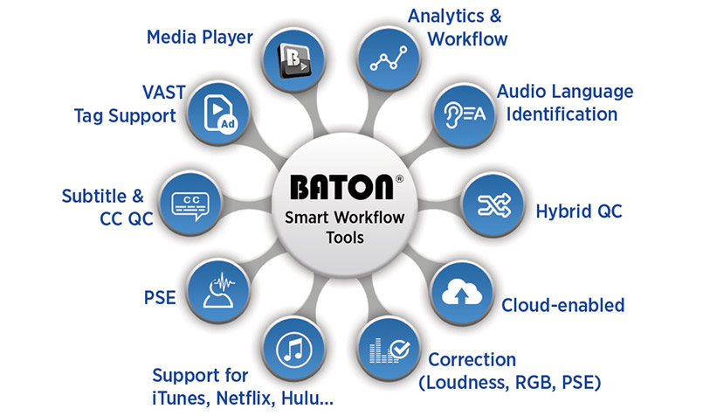
Quality Control
Types of QC
Machine-based – software tools
Commercial and open source

Slide 17
Quality Control
Types of QC
Machine-based – software tools
In-house scripts
[2017-04-14 18:22:13] [Xcoder:xcode-03:process_objects] Object 45000000242963 state
change: delivery_notify -> in_qc; Object is being checked
[2017-04-14 18:22:14] [Xcoder:xcode-03:process_objects] Object 45000000242963 state
change: in_qc -> failed; Object has failed Auto QC checks
pres/01: Cannot instantiate ffprobe object on
/srv/scratch/transcoder_workspace_xcode-03_prod//MDPI_45000000242963.20170414-174405/data/MDPI_45000000242963_01_pres.mkv. Corrupted?
[2018-04-04 02:47:28] [Xcoder:xcode-02:process_objects] Object 45000000220183 state change: in_qc -> failed;
Object has failed Auto QC checks
mezz/01: Expected 4 for number of audio streams(format:default) but got 1 instead.
mezz/01: Expected 1 for audio channels(audio:0) but got 2 instead.
pres/01: Expected 4 for number of audio streams(format:default) but got 1 instead.
pres/01: Expected 1 for audio channels(audio:0) but got 2 instead.

Slide 18
Quality Control
Types of QC
Human-intensive
Relies on human senses
Characteristics not assessed well by machines
Reversed audio, changes in speed
Metadata mixup—content does not match title
Metadata value is logical but incorrect
QC—It takes a person…

Slide 19
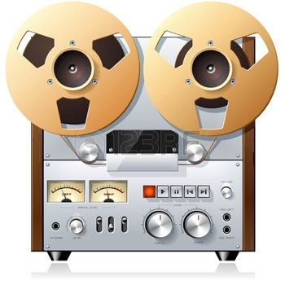
Quality Control
Human-intensive QC
Without source recording
Direct– compare source recording with file

Slide 20
Quality Control
Selection for QC
Value-based
More valuable = more resources

Slide 21
Quality Control
Selection for QC
Risk-based—by risks of a specific workflow

Slide 22
Quality Control
Risk-based QC
Anything new—format, personnel, equipment, procedures
Anything that changes/ stops and resumes
Certain formats
Workflow specifics

Slide 23
Quality Control
Quality control as risk management
Risk is the chance of a loss
Risk in digitization—files do not meet spec for preservation

Slide 24
Quality Control
Quality control as risk management
There is a risk that…
there are digitization errors (loss of accuracy)
it could be done better (loss of accuracy)
there are metadata errors (loss of context and interpretability)
it was not done at all (loss of preservation)

Slide 25
Quality Control
Quality control as risk management
Impact
Errors--researchers use inaccurate representations
Done better--lower quality representations
Metadata errors—incorrect judgments
Content not preserved

Slide 26
Quality Control
Quality control as risk management
Typical risk response strategies
Reduce risks
Avoid risks
Transfer risks
Accept risks

Slide 27
Quality Control
IU scenario
Memnon—own robust QC and QA programs
Not part of this presentation
IU understanding partly retrospective

Slide 28
Quality Control
IU scenario
Reduce or mitigate risk
Fragile formats (cylinders, lacquers) go to IUMDS 1:1 workflow
QA function

Slide 29
Quality Control
IU scenario
Reduce or mitigate risk
Human-intensive QC—random 10%
Direct QC
Retrospective QC program

Slide 30
Quality Control
IU scenario
Reduce or mitigate risk
Selection criteria for QC efficiency
Risk-based QC
Open reel audio azimuth adjustment—Direct QC
Complexity of formats—LP vs Open reel audio
More complex = more resources

Slide 31
Quality Control
IU scenario
Reduce or mitigate risk
Selection criteria for QC efficiency
Value-based QC
LPs and 45s
Stakeholder assessments
Lower value = fewer resources
LPs—1.6% checked
45s—1.8%
CD-R—3.6%

Slide 32
Quality Control
IU scenario
Avoid risk
Automated machine-based QC
Post-processing system developed by IU Libraries
Checks all files
~0% chance of error

Slide 33
Quality Control
Packager app
Script that runs on local capture machine
Set to run every evening
Acts on files created during the day
Embeds metadata
Creates derivatives

Slide 34
Quality Control
Packager app QC
Stops if digiprov including signal chain and settings metadata is missing
Stops if any of the following are missing: format, unit, barcode, IARL, ICMT, and BEXT

Slide 35
Quality Control
Post-processing system QC
Confirm directory is named MDPI_<barcode>
Confirm all file names begin with MDPI_<barcode>
Parse XML manifest
Confirm expected file types for format—pres, prod, mezz, presInt, access
Check for extra files not in manifest
Check for extra files in manifest not in delivery
Verify checksums
Verify file extension for file type is as expected

Slide 36
Quality Control
Post-processing system QC for audio
Confirm file extension–.wav
Check audio stream count
Confirm sample rate, bit depth, codec name, channels
Compare duration of preservation master and all derivatives

Slide 37
Quality Control
Post-processing system QC for video
Confirm format and wrapper
Check audio stream count, video stream count, duration of streams
Confirm sample rate, bit depth, codec name, channels for audio streams
Check codec name, width, height
Confirm frame rate
Confirm pixel format YUV 4:2:2
Duration checks across streams (audio, video) and across file types

Slide 38
Quality Control
IU scenario
Transfer risk
Classic example—insurance
Digitization—vendor contract
Time period for free re-digitization
40 days audio/30 days video

Slide 39
Parallel Transfer Workflows
Accept risk
38,000 open reel audio tapes
1950s-1990s
Jacobs School of Music
Recitals and concerts
Famous and prominent classical and jazz musicians interspersed
Most of moderate value

Slide 40
Parallel Transfer Workflows
Accept risk
Parallel transfer or 1:1 digitization?
1:1 workflow = 27.86 Years
4:1 workflow = 7.43 years

Slide 41
Quality Control
IU scenario
Procedures and tools

Slide 42
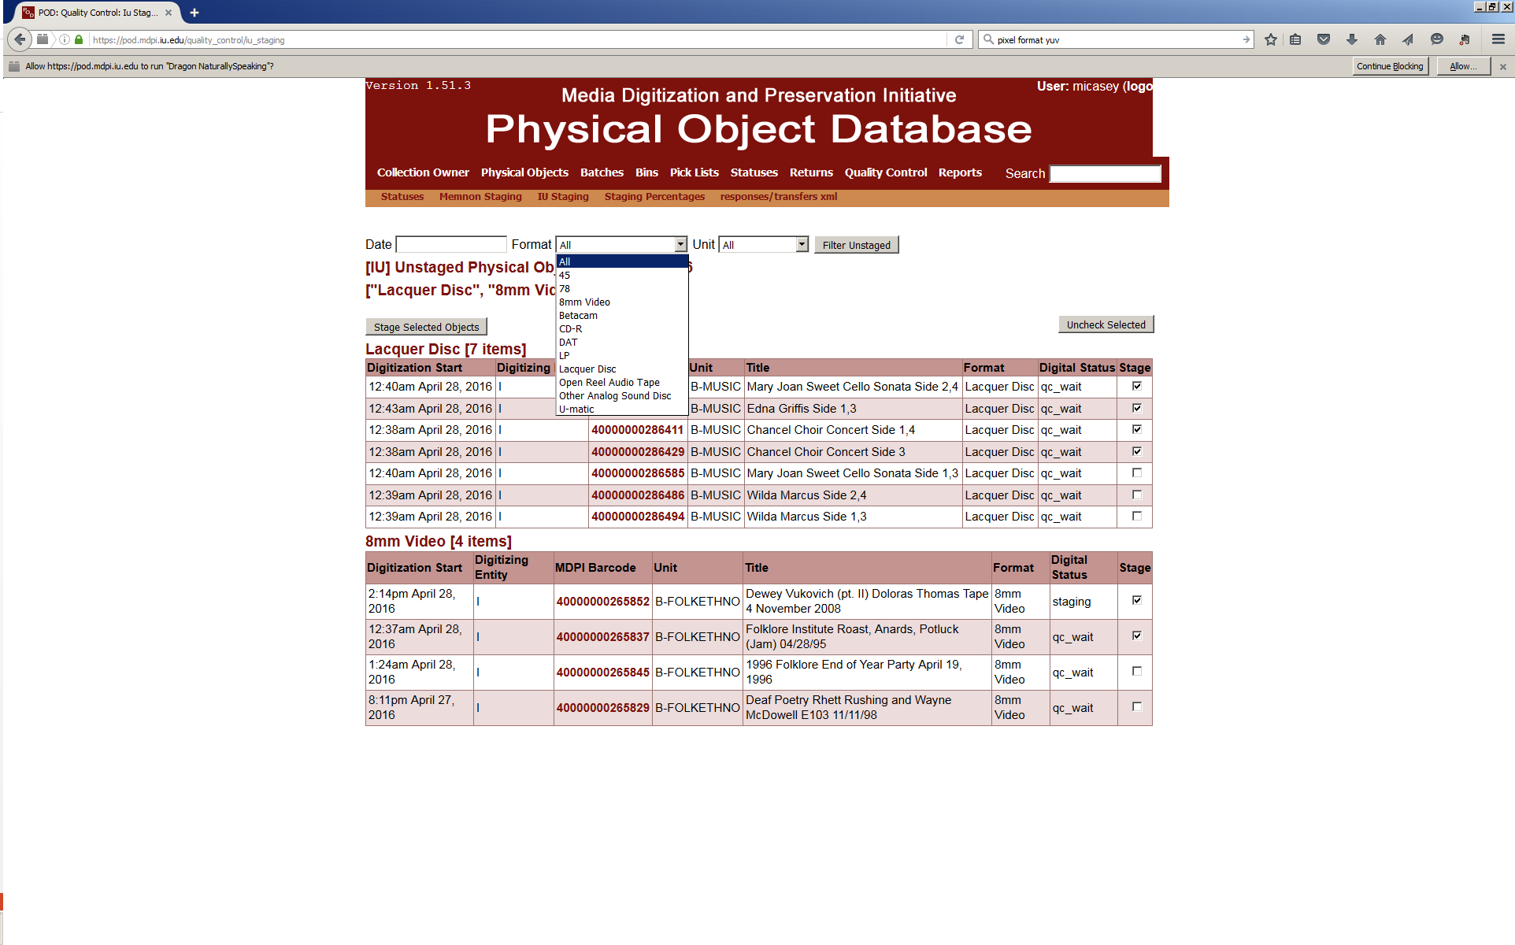
MDPI QC Workflow

Slide 43
Quality Control
Targets
Imagined – 10%
Actual to date—11.5%

Slide 47
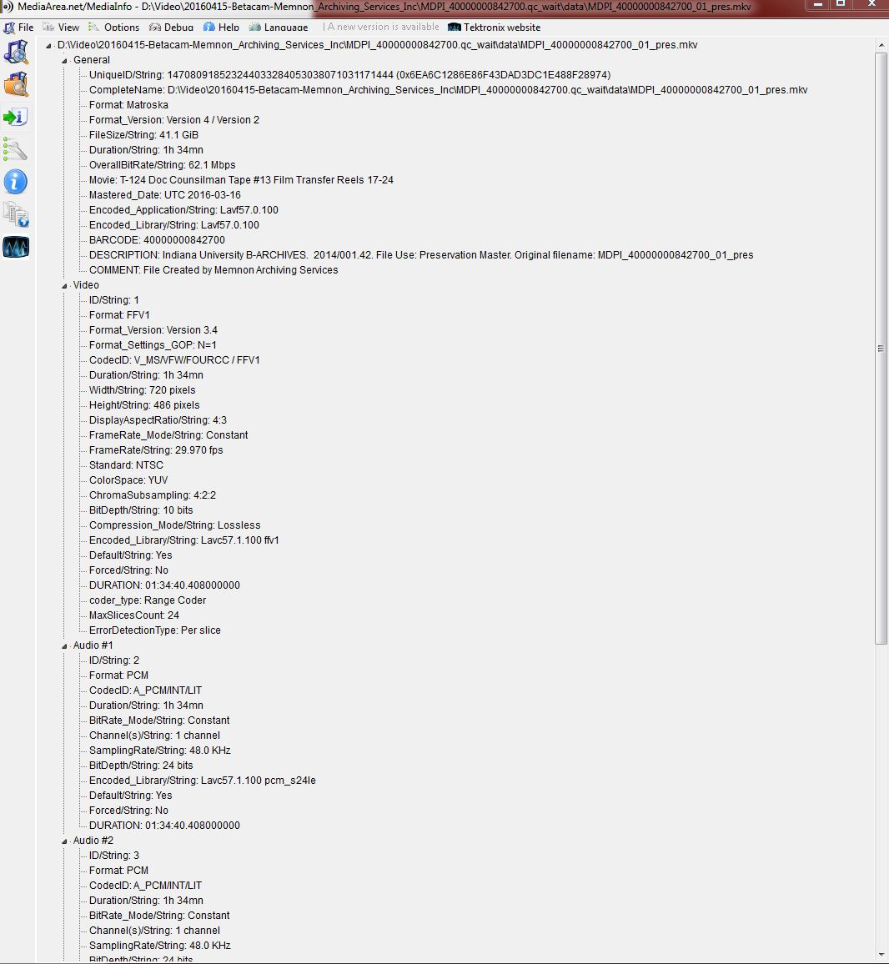
Tools: MediaInfo

Slide 48
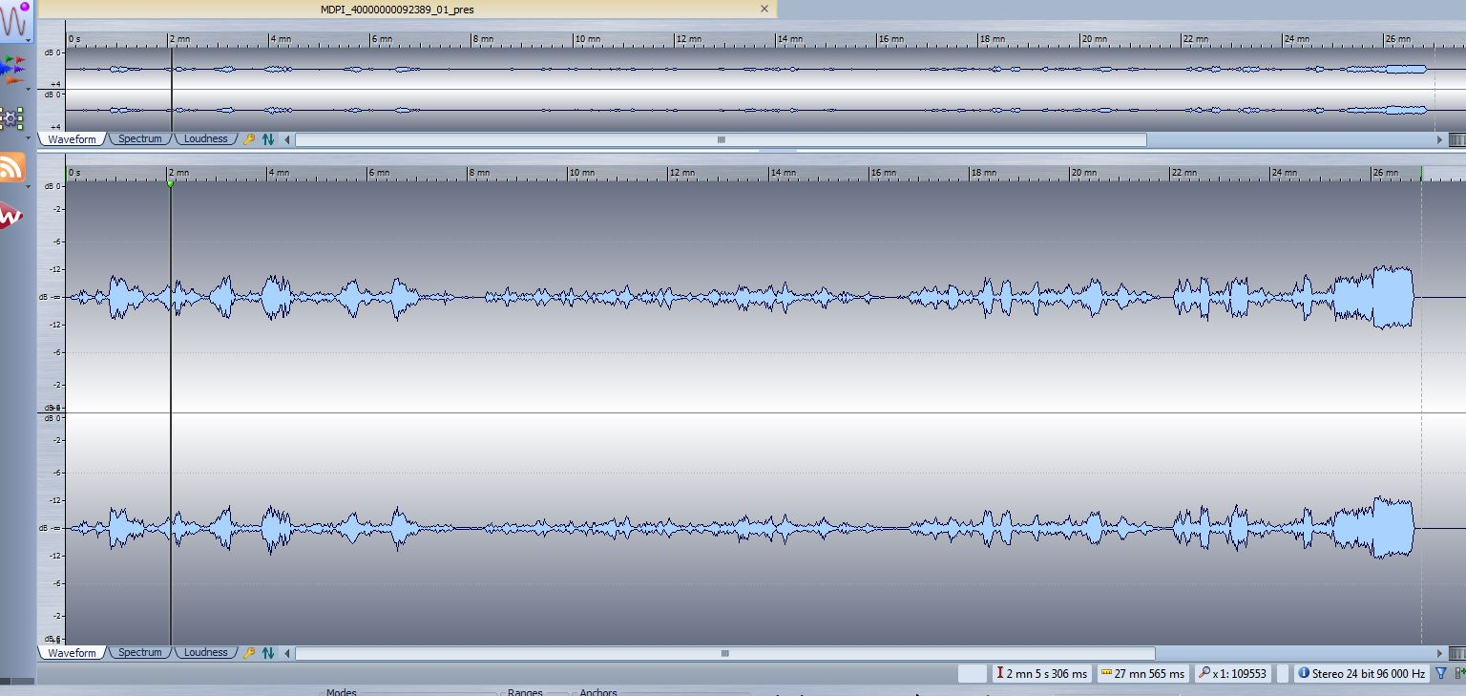
Tools: WaveLab

Slide 49
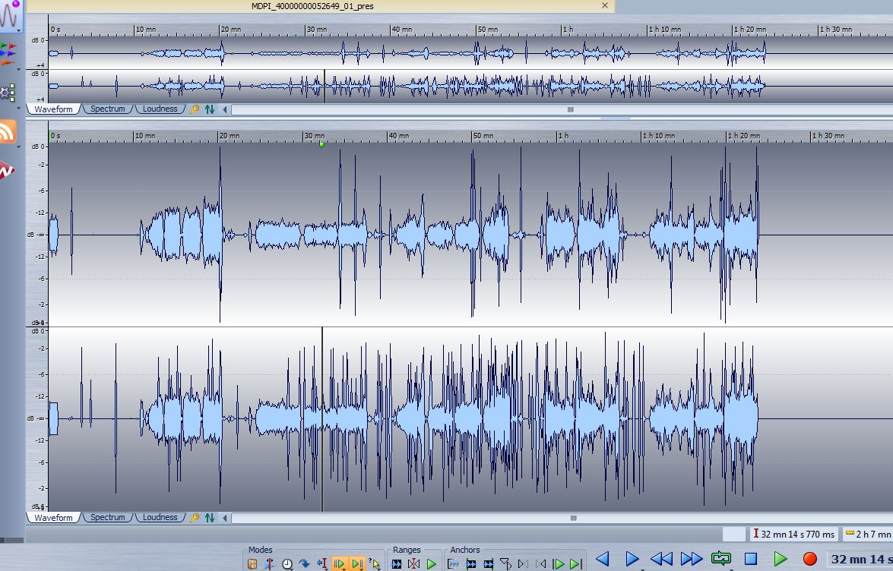
Waveform: DATs

Slide 50
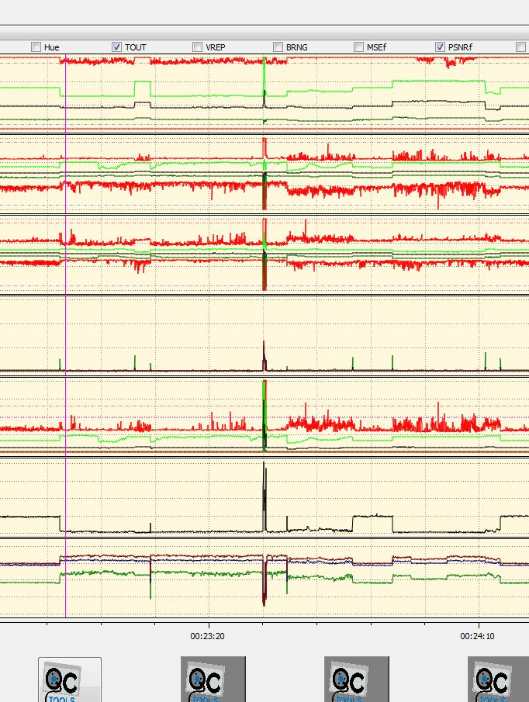
Tools: QCTools (Clogged Head)

Slide 51
MDPI QC Workflow
What is our job?
Tedious work
Not just find errors
Validate that files meet preservation spec

Slide 52
MDPI QC Workflow
What have we found?
29,984 recordings human-intensive QC
Very few problems overall--0.7% failed by IU QC
Most issues found are in metadata, particularly comments
45% of 0.7% failed resulted in re-digitization

Slide 53
MDPI QC Workflow
What have we found?
A few reversed audio issues
Some variable speed issues
A few azimuth adjustment issues
Several problems with machines
Low video levels

Slide 54
MDPI QC Workflow
Issues:
QC Specialist sends note to list
The following VHS file has failed IU QC:
40000001522970
This file has failed for the following reason:
40000001522970: Overall blue hue throughout duration.
Adam Nickel
Processing and Quality Control Specialist
Media Digitization and Preservation Initiative - Indiana University
https://mdpi.iu.edu/

Slide 55
MDPI QC Workflow
Issues:
Memnon invokes CCC procedure
Containment
Cause
Corrective Actions
Opportunities for improvement of system

Slide 56
MDPI QC Workflow
Issue: VHS: 40000001522970: Overall blue hue throughout duration.
Containment:
VHS-004 (SN: K6TC00005) was determined to be the source of this issue, machine was replaced. Researched all tapes transferred on this machine to determine when issue started 11/30 - 12/5, resulting in (41) tapes being re-digitized.
Cause: Unsure of specific player defect resulting in blue tint.
Corrective Actions:
Tape machine serviced.
All (41) tapes with blue tint have been redigitized

Slide 57
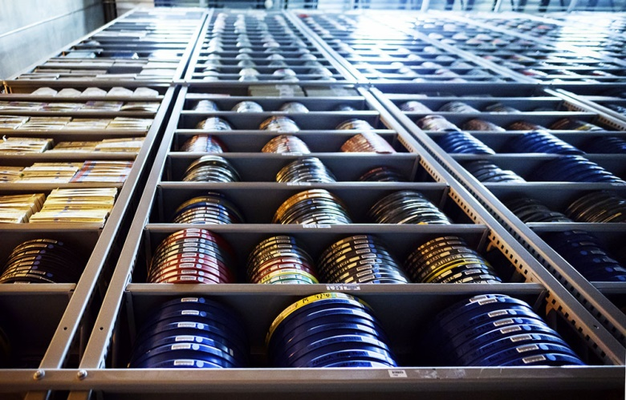
MDPI2: Film Digitization

Slide 58
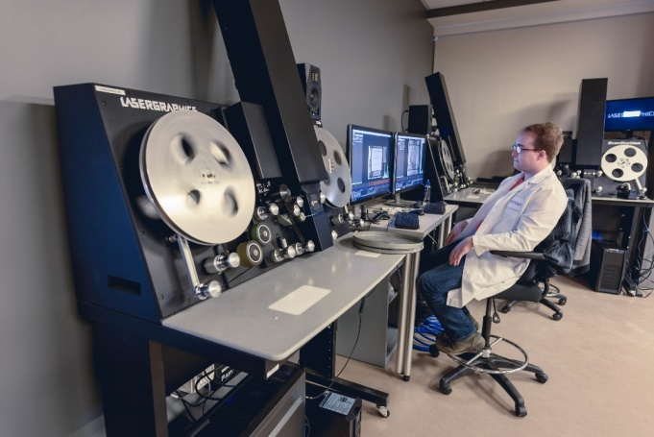
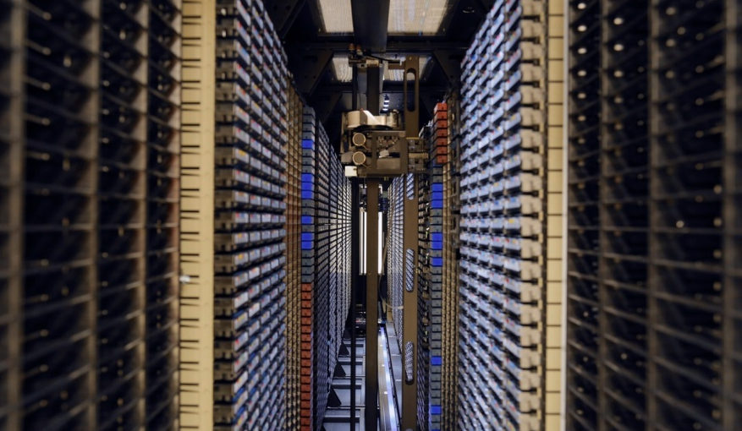
MDPI2: Project Overview
30,000+ of 100,000+ Reels
Within 3.5 years
Digitization done by Memnon using Laser Graphics Scanstation

Slide 59
MDPI2: Project Overview
Reels provided by:
Archives of African American Music and Culture
Archives of Traditional Music
Black Film Center/Archive
IU Libraries Moving Image Archive
Kinsey Institute
Lilly Library
University Archives
University Athletics
Regional Campus Archives

Slide 60
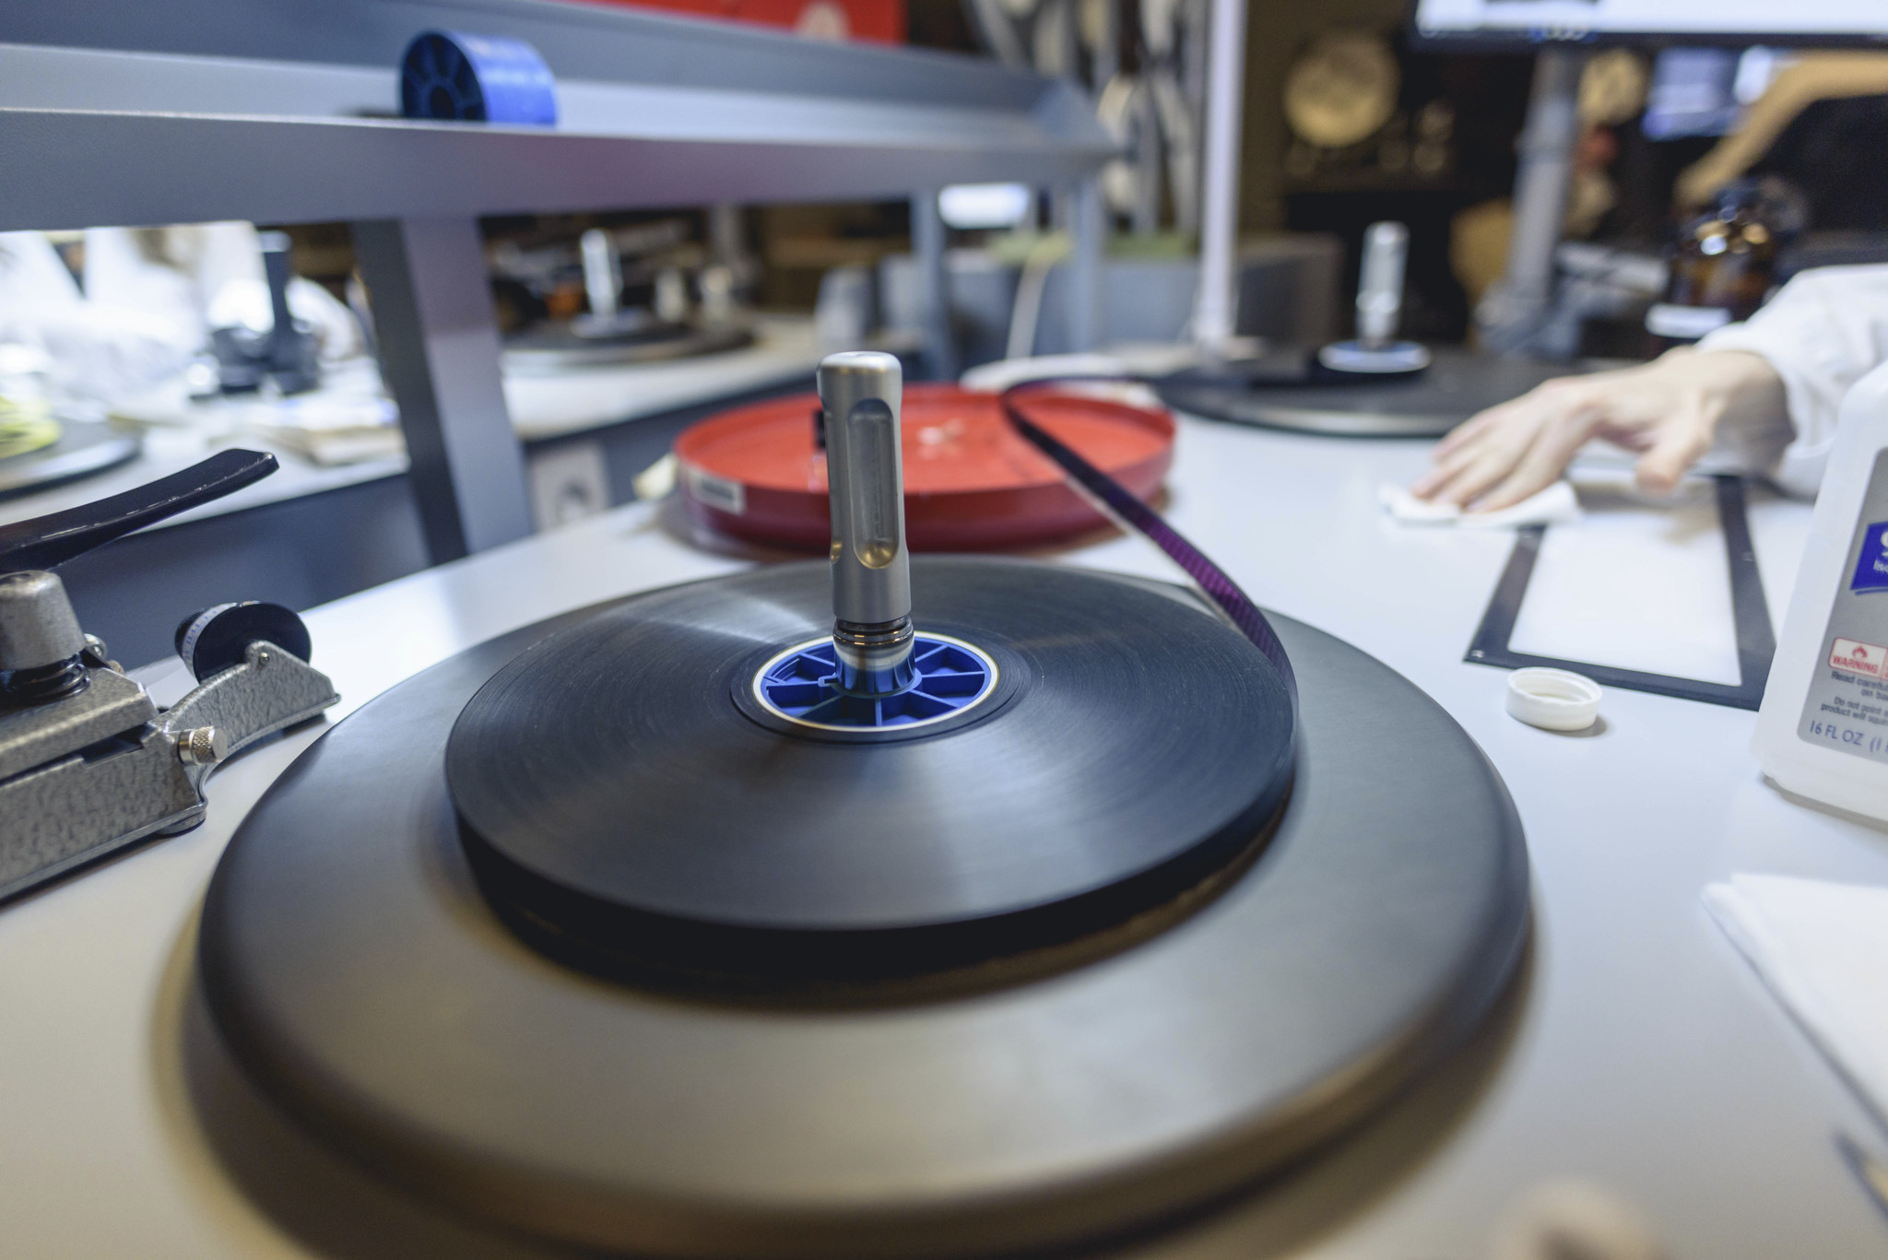
MDPI2: Project Overview
IU Libraries Moving Image Archive (IULMIA)
Coordination with collection holders
Knowledge and research of collections
Best copy selection
Film Preparation/Returns
Works closely with QC Team

Slide 61
Quality Control Needs - Film
Submission Package QC
Handle Up to 27TB per Day
Image and Sound QC
100% Mezzanines
10% Preservation Masters
< 16 hrs content / day
Fast Identification, Communication & Reporting for Potential Failures
Overscan DPX + Broadcast Wave in a Tarball
Overscan ProRes 4444
Crop / Color Corrected ProRes 4444
Scanner Project File (.cdir)
Technical & Digital Provenance Metadata (XML)

Slide 62
Submission Package QC – IU Library IT Build
Fully automated QC confirming ….
Package Structure
Checksums
File Naming Conventions
Valid Bag
Correct # of DPX Frames
Compare Deliverables to XML:
- Durations - Codec
- Bit Rate - Frame Rate
- Color Space - Height x Width
- # A/V Channels - Pixel Format
Notes:
XML = Technical and Digital Provenance Metadata

Slide 63
Submission Package QC – IU Library IT Build
Fully automated QC confirming ….
Notes:
XML = Technical and Digital Provenance Metadata

Slide 64
Image and Sound QC Approaches for Scanned Film
Full Manual QC
Watch scanned film from begin to end
Extremely time/cost intensive and exhausting
Spot-Checking
Play/check only a few spots of scanned film
Fast, but missing issues in between
Semi-Automated QC (VidiCert)
Analyze scanned film from begin to end, suspicious sections found are verified by human
Fast and full temporal QC coverage

Slide 65
Film QC Workflow
Scanning Operations
2 scanners, two 8 hr shifts per scanner per day
Creating up to 4 hrs of content per shift = up to 16 hrs of content per day
QC Operations
2 FT QC Specialists
QC of overscan and crop version = up to 32hrs of QC content per day
3 VidiCert Analyzers, 2 VidiCert Summary stations
Current QC throughput: ~50 files = 15 hrs per person in a 8 hours shift
Notes:
MPDI ….. Media Digitization & Preservation Initiative

Slide 66
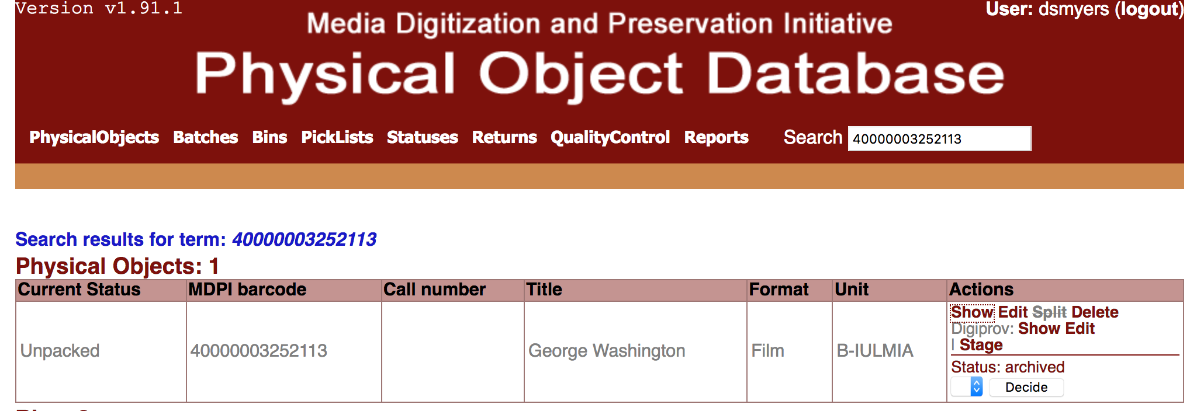
Film QC Workflow
Notes:
MPDI ….. Media Digitization & Preservation Initiative

Slide 67
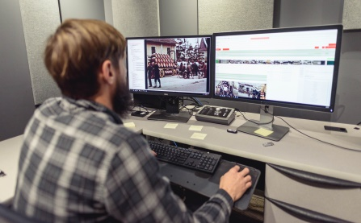
Film QC Workflow
Notes:
MPDI ….. Media Digitization & Preservation Initiative

Slide 68
Image and Sound QC
Confirm – Preservation Overscan
Completeness
No Image / Audio Loss
No Image / Audio Corruption
Playback Speed
Film Prepared well for Scanning
Faithful Representation of Original
Confirm – Access Copy (Cropped)
Minimal Frame Lines
Acceptable Color Correction for Dye Faded Stocks
Create QC Report
Notes:
All films – 5-10 mins to QC regardless of duration
Higher importance titles/elements 15 -20 mins to QC
VidiCert’s automatic filters help us be smarter about which portions of the film to investigate instead of random spot checking.
Use automatic defects and graphs to investigate areas of high dust or suspected blur. Some false positives for printed in errors and things like water or birds flying misinterpreted as dust.
Postpone questionable films for group reviews
Access Copy – As for quick viewable copy for streaming to get content up quickly. Not perfect but improved for ease of viewing. Any title identified as high importance after the fact can be selected for further preservation/restoration work.

Slide 69
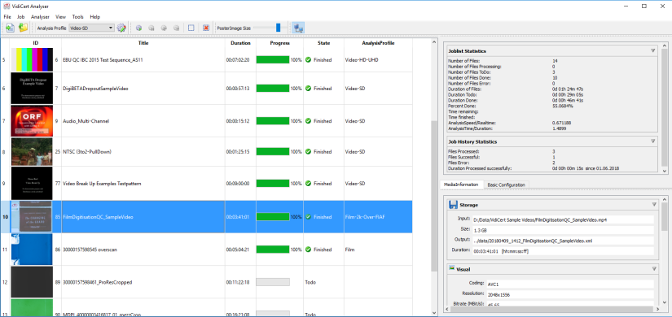
Image and Sound QC Automated Defect Detection Functions
Gamut/Clipping (Under & Over Exposure)
Freeze Frame
Framing Error
Dust/Dirt/Hair Level
Film Grain Noise Level
Out of Focus / Blurriness Level

Slide 70
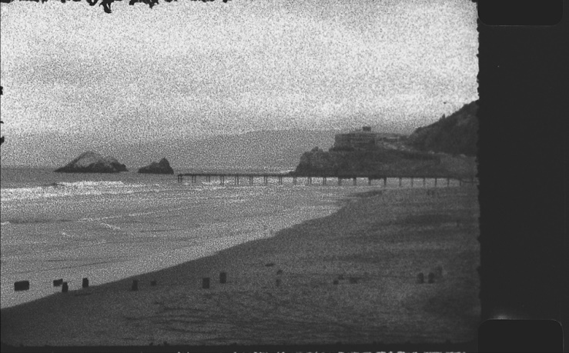
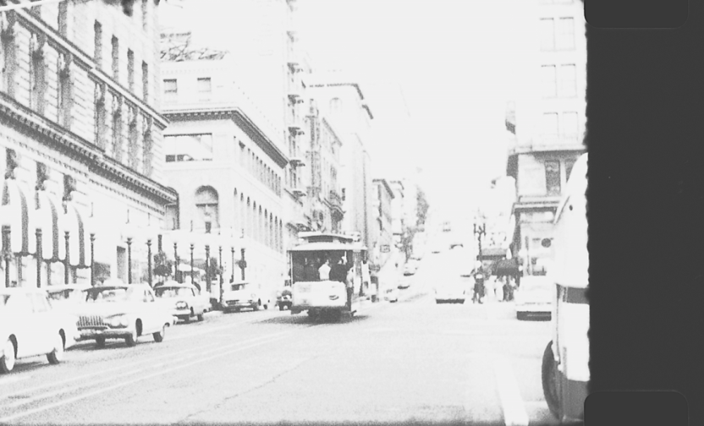
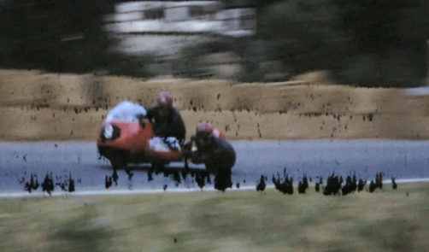
Image and Sound QC Automated Defect Detection Functions
Contrast/Luminance Range
Black & Single Colored Frames
Black Bar / Aspect Ratio
Macroblocking
Audio Silence, Loudness, Superimposed Sound

Slide 71
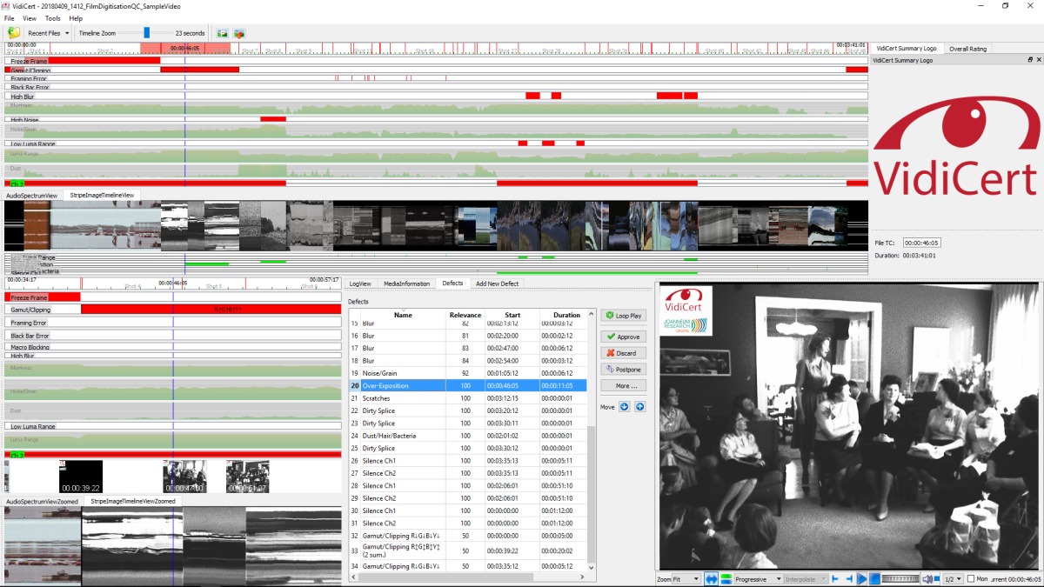
Image and Sound QC Interactive Defect Verification
Advanced summarization and navigation by various timeline based defect and quality measure views
Full featured desktop player: zoom, field split, time accurate playback, second monitor full screen, selectable audio channels
Fully customizable user interface with presets

Slide 72
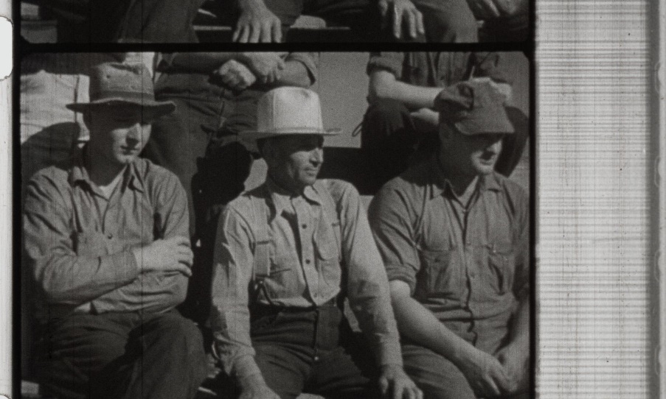
Image and Sound QC Stripe Image
Image Loss & Framing
Faded Stock – Color Correction Needed

Slide 73
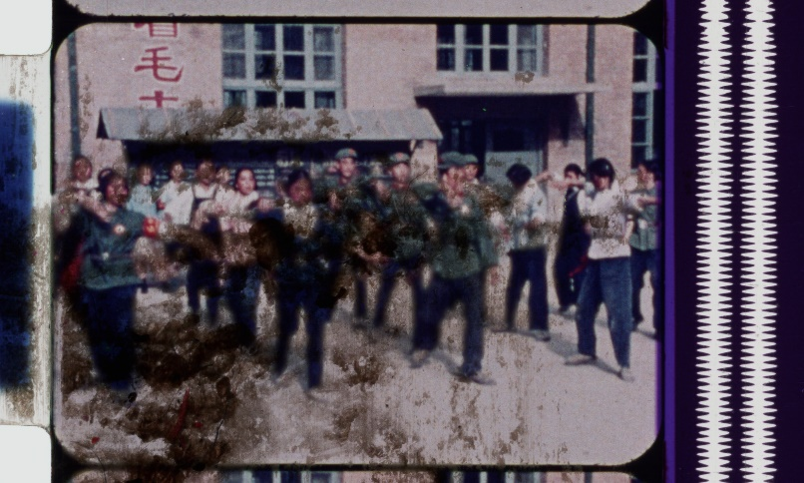
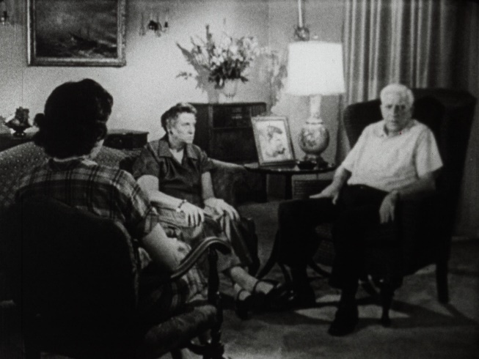
Image and Sound QC Identified Defects
Dirt / Dust
Crushing / Clipping
Foreign Object in Frame
Added Tones
Notes:
An example of how errors can creep up suddenly…
VidiCert Gamut & Luma Error detection greatly improves our speed to identify this error – 7 in July, 19 in August, 2 in September
Helped identify quickly a new element group of negatives that were creating crushing in scans unlike other negatives.
Dust and focus filters create graphs to help us pinpoint sections of film to quickly spot check.
Audio Spectrum helps us check for audio loss and introductions of tones, which we had early on. This led to the scanner manufacturer updating their optical reader.

Slide 74
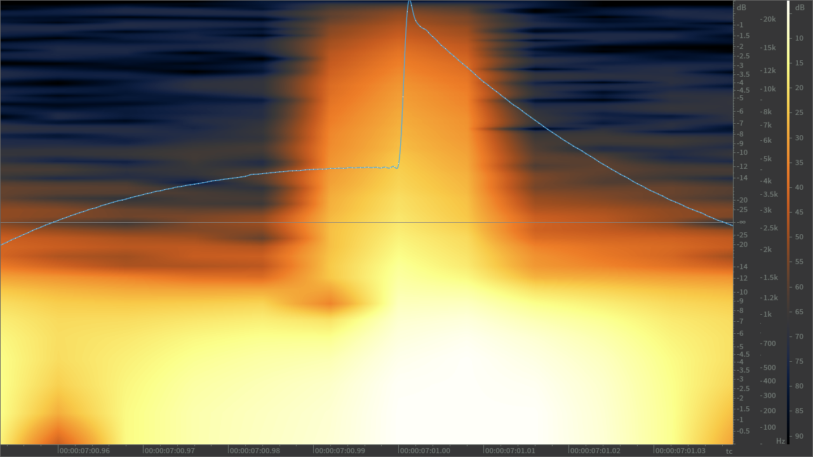
Image and Sound QC Identified Defects
Dropped Audio Samples
(Interstitial Type Errors)
Caused by Film Instability
Identified in iZotope RX
Fixed with R&D/Software Updates
A/V Sync Issues
Caused by Shrunken Film
Identified by QC Specialist
Developed Manual “Sync. Test”
Fixed with R&D/Software Update

Slide 75
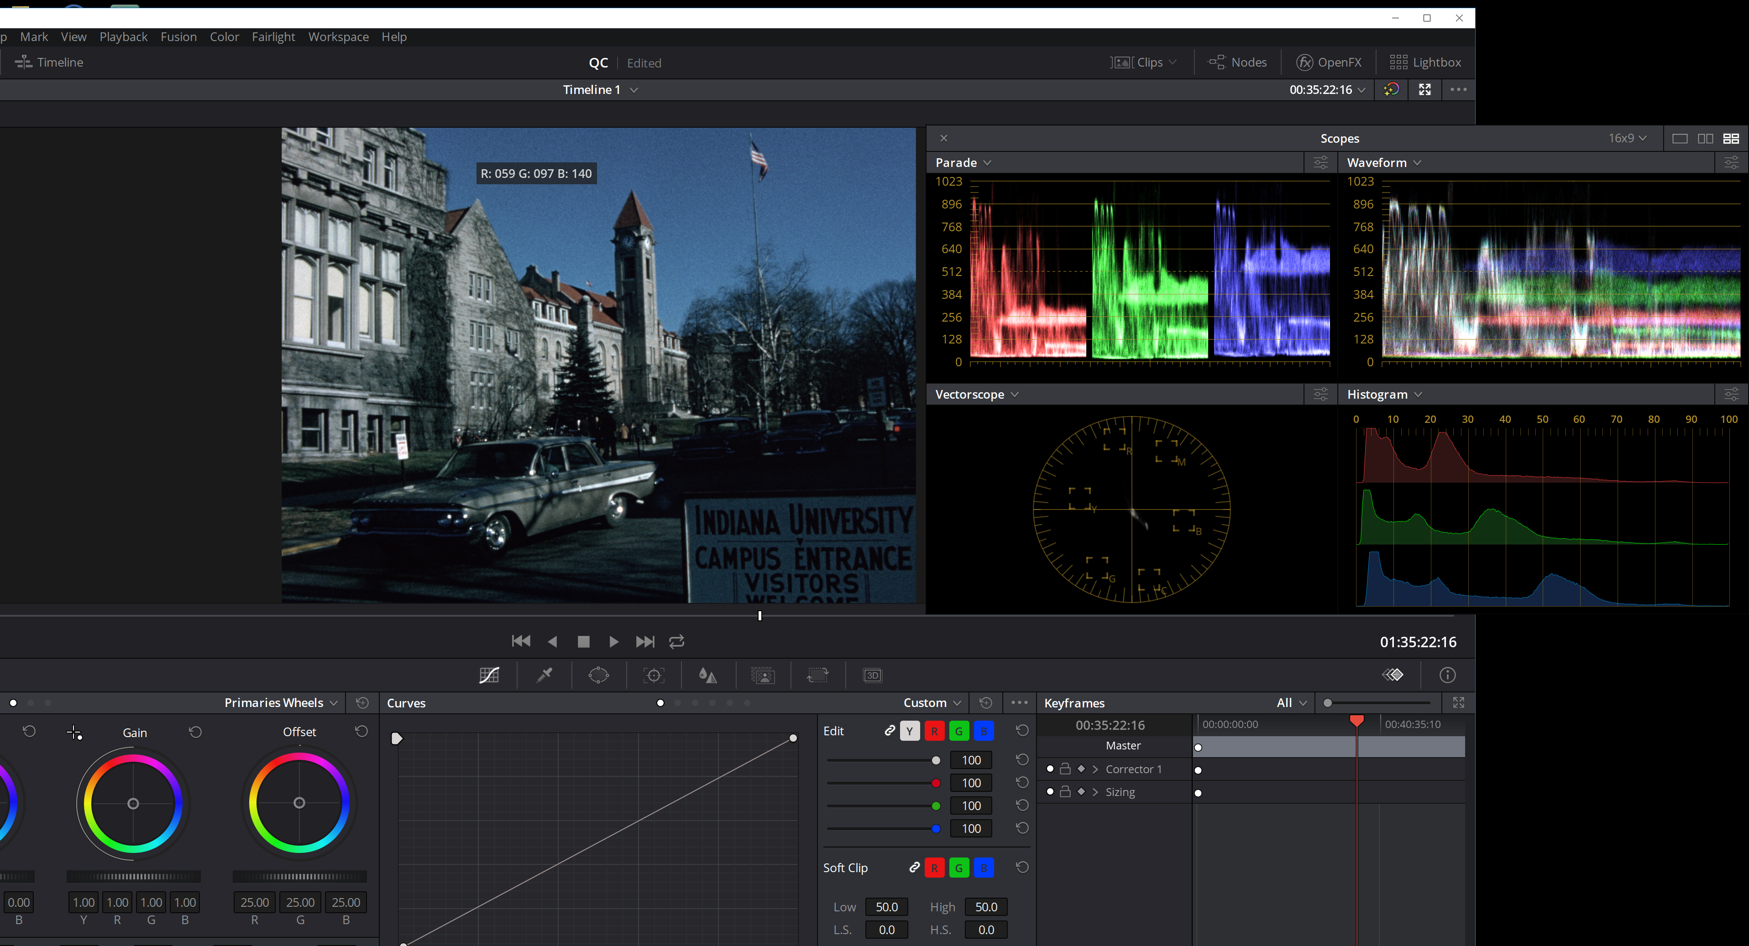
Image and Sound QC Identified Issues
Da Vinci Resolve
Verify Playback Speed (FPS)
RGB Levels
Side by Side Comparisons

Slide 76
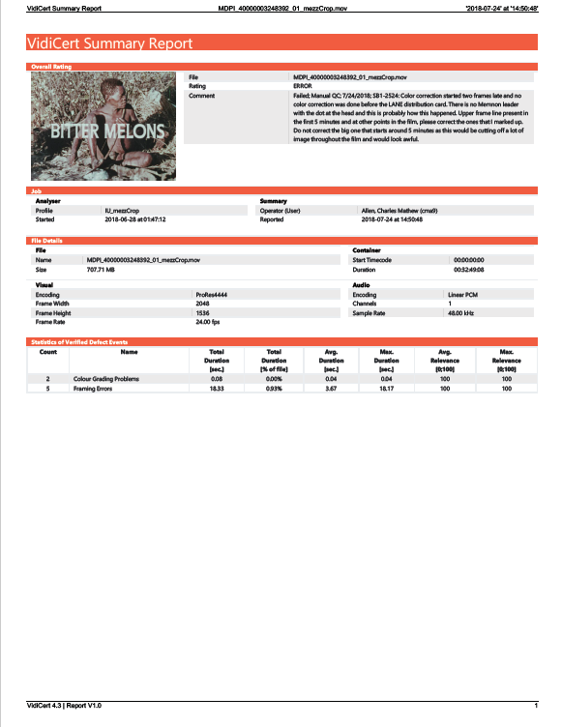
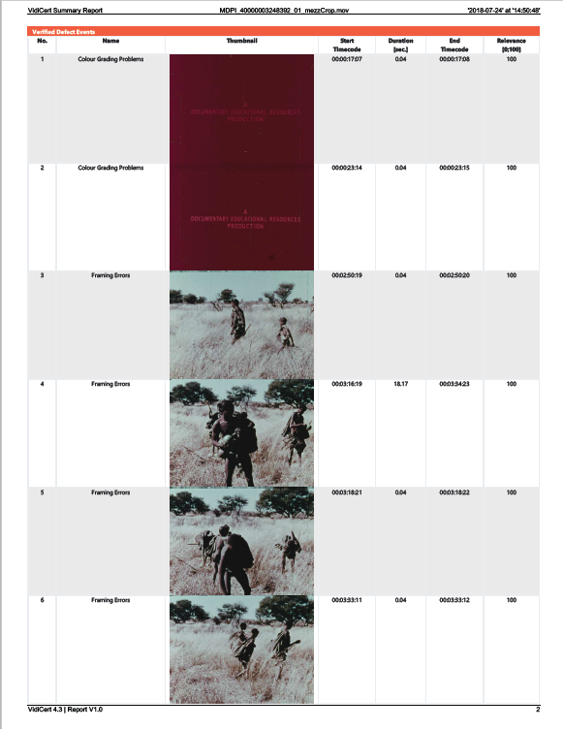
Reporting

Slide 77
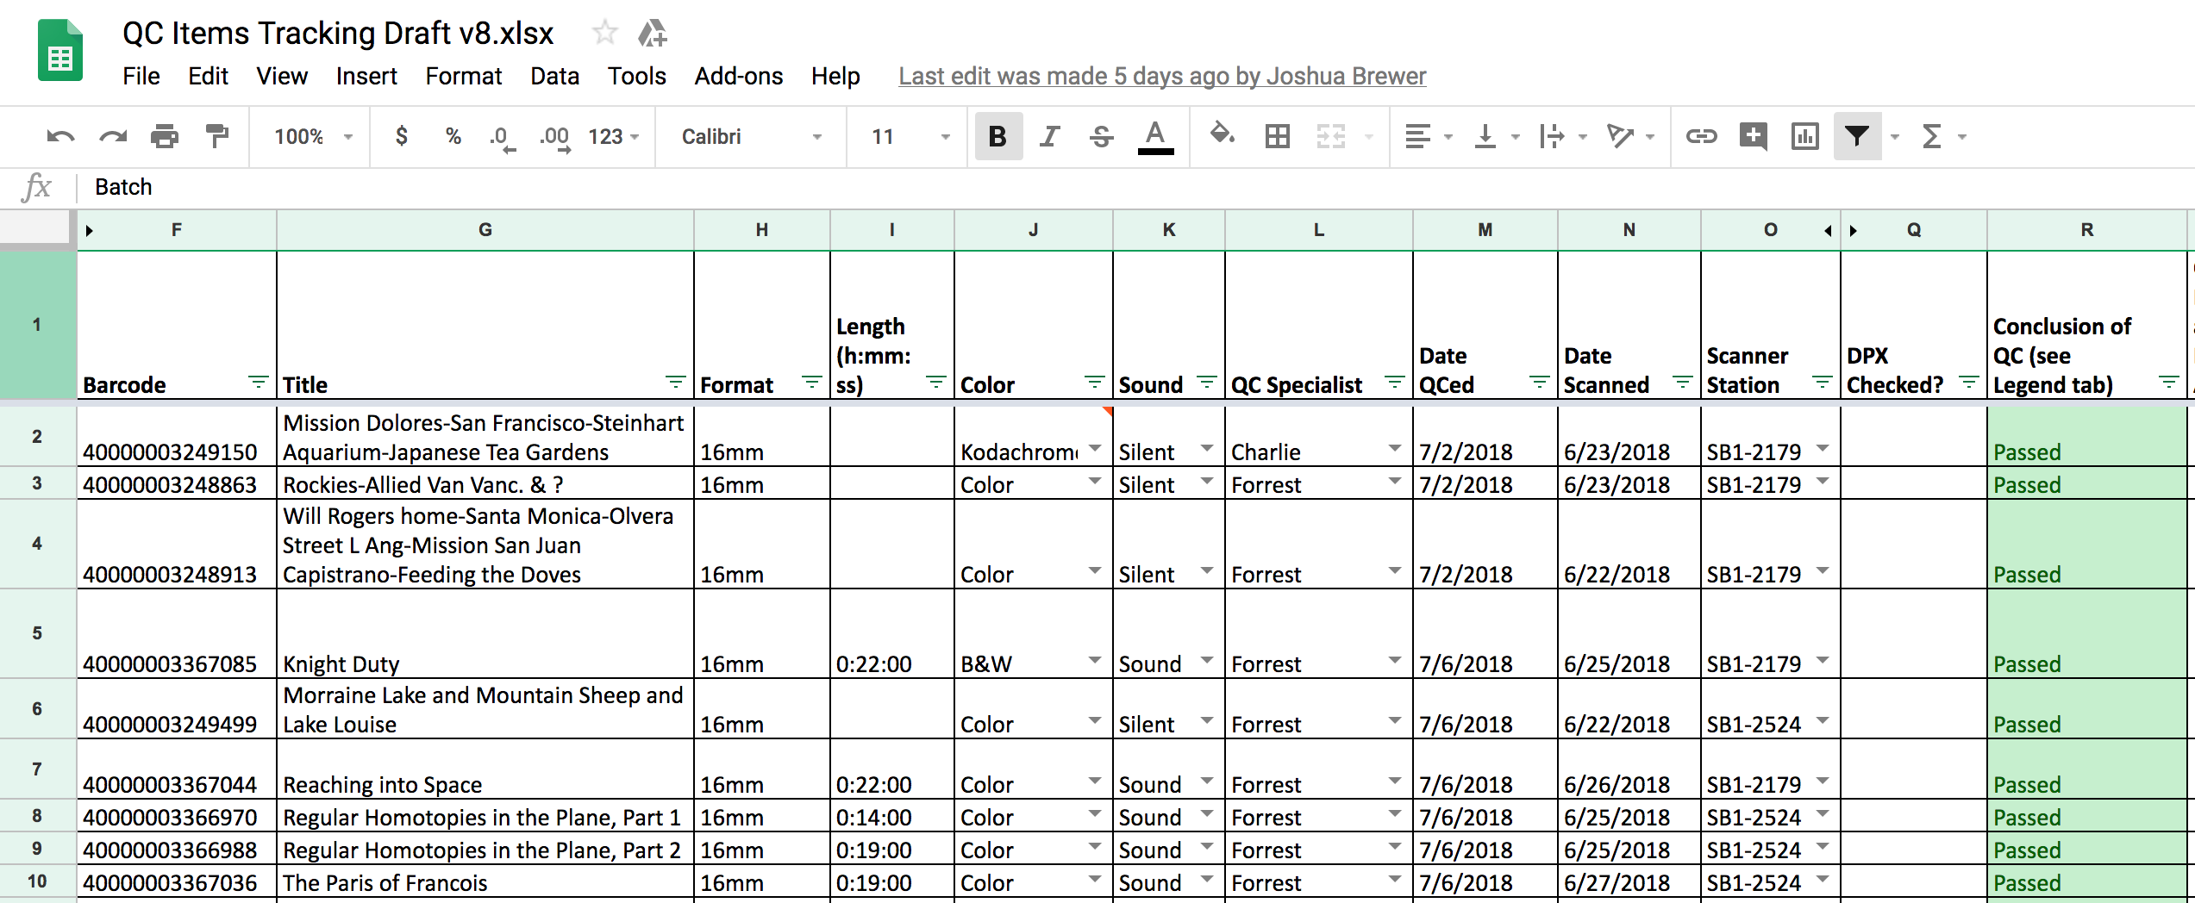
Reporting and Tracking

Slide 78
Image and Sound QC What have we done?
Human-intensive QC
December 2017 – October 2018
7,883 titles (15,766 files)
Average file duration: 16 Min. 06 Sec.

Slide 79
Image and Sound QC What have we learned? (from QC or affecting QC)
Challenges
Unusually heavy use of scanners in two scanner workflow over two shifts per day
Maximize both quality and speed
Various hardware and software issues to work through
Need to engage in R&D while doing production

Slide 80
Image and Sound QC What have we learned?
Challenges
Re-start at beginning of project
Cleaner failure
Human error (expected)
Incorrect scanner settings
Excess dirt on film
Stabilization problems on films with physical issues

Slide 81
Image and Sound QC What have we learned?
QC program
Identified audio and image issues
Fed data into R&D process
Grew better with experience (learning curve)
Helped vendor become more accurate

Slide 82
Image and Sound QC Most Critical Issues & Effectiveness
QC allows to detect defects -> Files „To be Re-Scanned“
QC+Re-Scan reduces the total defects rate per file from 3.2 to 0.6 ->More than 5 times less issues (Archived vs. Re-scanned)

Slide 83
MDPI Operations Overview Re-Scans per Month
Goal of QC is to drive down rescans - September rescans down to 6%
IU requests some rescans for reasons other than defects
Requirements and complexity change for some collections and film stock
Scanner and Film Cleaner equipment issues led to spikes in March and July
Were detected and solved
Notes:
03/18 Optical reader changed to image based sound reader, this introduced interstitial errors (e.g. pops) in the beginning (software has been revised)
07/18 Scanner of new negative stock (crushing in the whites) produced crushing in the darks (in the positive)
07/18 Film Cleaner Problem

Slide 84
Conclusions…
Approach to QC is a project strength
Allows IU to better understand its diverse collections and adapt workflows
Enables high quality archive package
Submission Package QC
Ensures packages meets archiving standards

Slide 85
Conclusions…
VidiCert Image and Sound QC
Integrates very well with IU workflow and Submission Package QC
Systemic issues can be detected quickly
Detailed automatic and interactive detection functions helps greatly in finding the origin of an issue
Strengthens our relationship with Memnon

Slide 86
MDPI QC Workflow
The big picture:
Preserve for long period of time
Humans make mistakes
Validate content meets preservation spec
Correct errors
Understand risks—mitigate or accept
Provide access to quality content produced by quality digitization system

Slide 87
Things of Quality Have No Fear of Time
--Author unknown

Slide 88
Quality Control for Media
Digitization Projects
Mike Casey (micasey@indiana.edu)
Director of Technical Operations
Darrell Myers (dsmyers@indiana.edu)
Post Production and Quality Control Specialist
Indiana University MDPI
Blog: http://blogs.iu.edu/mdpi/
“Things of Quality Have No Fear of Time”

