Slide 1
Ten Years of Success
(Mostly)
The Nitrate Committee’s Flickr Page

Slide 2
Unid. Woman in Technicolor Test?
Uploaded June 2013 – remains unidentified.
www.flickr.com/photos/nfig/albums

Slide 3
Unid. Masked Rider Western
Uploaded December 28, 2010 – remains unidentified
www.flickr.com/photos/nfig/albums

Slide 4
Rachel fall of 2008. So young… so naïve…
BTW, the blonde is not unidentified. She’s a friend from college, Dannielle. Hi Danni!

Slide 5
Brian Meacham out and about
Brian is also not unidentified.
Hi Brian!

Slide 6
Albums / sets on flickr
www.flickr.com/photos/nfig/albums

Slide 7
Identified: Her First Kiss
Uploaded December 15, 2011 and identified within days
www.flickr.com/photos/nfig/albums

Slide 8
Unidentified Italian Silent Comedy
An image from the very first unidentified film uploaded to the Nitrate Film Interest Group’s Flickr page. Uploaded on September 1st, 2008 – remains unidentified. *sigh*
www.flickr.com/photos/nfig/albums

Slide 9
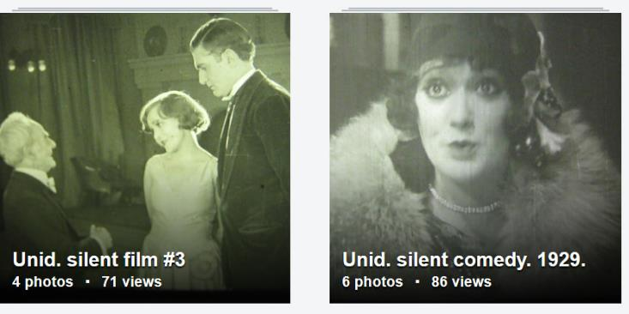
These will get identified no problem…
Ten years later…
Yep. Still unidentified.
www.flickr.com/photos/nfig/albums

Slide 10
Oh yeah. That One unidentified billy west film…
Uploaded November 2010 – remains unidentified.
www.flickr.com/photos/nfig/albums

Slide 11
unid. Sid Smith and Paul Parrott vie for Gladys Varden
Uploaded July 24, 2017 – remains unidentified
www.flickr.com/photos/nfig/albums

Slide 12
unid. north America castle travelogue
Uploaded June 2017 – remains unidentified
www.flickr.com/photos/nfig/albums

Slide 13
Unid. Virginia Bruce? film
Uploaded January 11, 2013 – remains unidentified.
www.flickr.com/photos/nfig/albums

Slide 14
Unid. Ah! Sweet Mystery of Life singer
Uploaded August 5, 2016 – remains unidentified
www.flickr.com/photos/nfig/albums

Slide 15
Identified: “Won by Law"
Uploaded on December 30, 2010 and identified mere days later.
www.flickr.com/photos/nfig/albums

Slide 16
Unid. commedia del arte in Montreal
Uploaded June 29, 2016 – remains unidentified
www.flickr.com/photos/nfig/albums

Slide 17
Unid. Home movies?
Uploaded January 2011 – remains unidentified.
www.flickr.com/photos/nfig/albums

Slide 18
unid. Eva Thatcher and Joseph Franz drama
Uploaded on July 12, 2017 – remains unidentified
www.flickr.com/photos/nfig/albums

Slide 19
www.flickr.com/photos/nfig/albums

Slide 20
Unid. Brownie comedy - Hot Dog?
Uploaded August 2012 – remains unverified.
www.flickr.com/photos/nfig/albums

Slide 21
Unid. Performing Dogs
Uploaded June 25, 2012 – remains unidentified.
www.flickr.com/photos/nfig/albums

Slide 22
IDENTIFIED: ONE OF THE FINEST (1907) SELIG
Uploaded August 2011 – Identified six years later.
www.flickr.com/photos/nfig/albums

Slide 23
unid. Bobby Ray as boxer
Uploaded October 31, 2016 – remains unidentified
www.flickr.com/photos/nfig/albums

Slide 24
Identified: Country Chickens
Uploaded May 2011 and identified a few days later
www.flickr.com/photos/nfig/albums

Slide 25
Oh! That’s what I should have been doing!

Slide 26
Identified: “Hullo! Who's Your Lady Friend?”
Uploaded March 2011 and identified just days later.
www.flickr.com/photos/nfig/albums

Slide 27
Unid. Woman's Screentest
Uploaded March 28, 2012 – remains unidentified.
www.flickr.com/photos/nfig/albums

Slide 28
BECAUSE PIE CHARTS MAKE THINGS OFFICIAL
AS OF MONDAY NOVEMBER 26, 2018:
- 1,070 UNIDENTIFIED FILMS HAVE BEEN UPLOADED TO THE FLICKR PAGE.
- 425 OF THOSE HAVE BEEN IDENTIFIED AND VERIFIED.

Slide 29
unid. mistaken parents Bobby Vernon and Dorothy Devore
Uploaded on July 26, 2017 – remains unidentified.
www.flickr.com/photos/nfig/albums

Slide 30
And bar graphs are how official does official

Slide 31
Identified: The Impalement
Uploaded December 29, 2010. Identified shortly after
www.flickr.com/photos/nfig/albums

Slide 32
Identified: The Social Pirates
Uploaded November 17, 2008. Identified in 2010.
Spread the word.
www.flickr.com/photos/nfig/albums

Slide 33
unid. bill poster hangs "The End" sign
Uploaded on 10/15/2018
Have I mentioned the link? It is: www.flickr.com/photos/nfig/albums
You can contact me at:
rapa@loc.gov

